Slide 1
A TEACHER’S GUIDE TO
ENERGY
Giving Life and Creating Change
Notes:
Hello and welcome to GBRI’s presentation for energy education. As educators, you make an important impact on the minds of the future. And we at GBRI want to support your mission in enhancing your students' education, especially in relation to sustainability.

Slide 2
Learning Hub @ GBRI
Presents

Slide 4
A MODIFIABLE PRESENTATION
ENERGY CURRICULUM FOCUSED
This presentation is focused on providing a general understanding of energy and its implications.
It focuses on the State of Rhode Island at many points.
The links listed below can help you learn more about energy in your state!
Energy consumption: https://www.eia.gov/state/rankings/
Energy production: https://www.energy.gov/articles/how-much-energy-does-your-state-produce
Notes:
This presentation was created to help guide you through an energy-focused lesson plan that can be modified to suit your students’ needs.

Slide 5
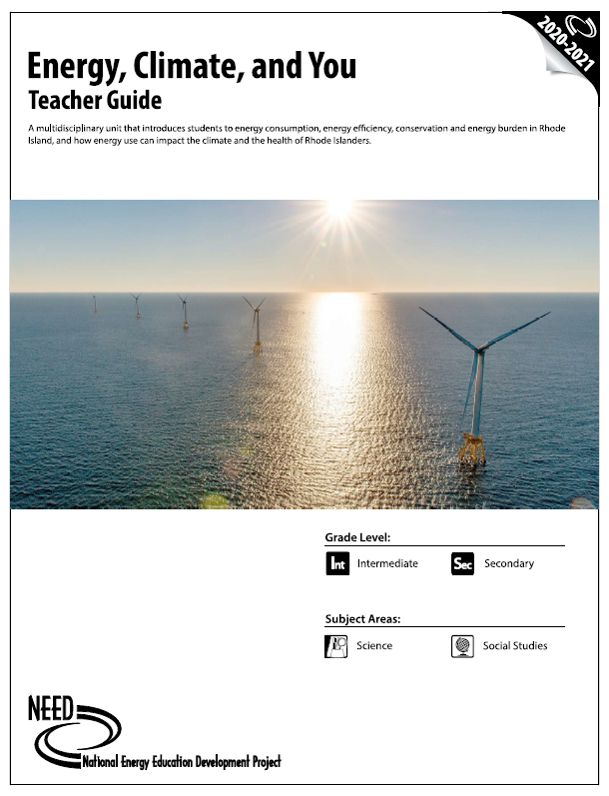
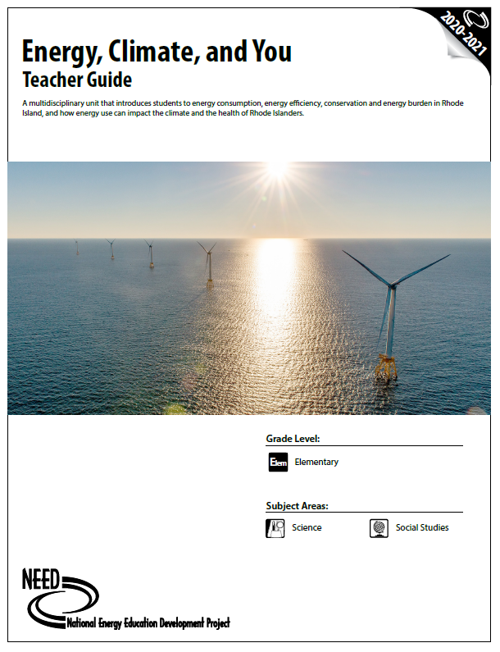
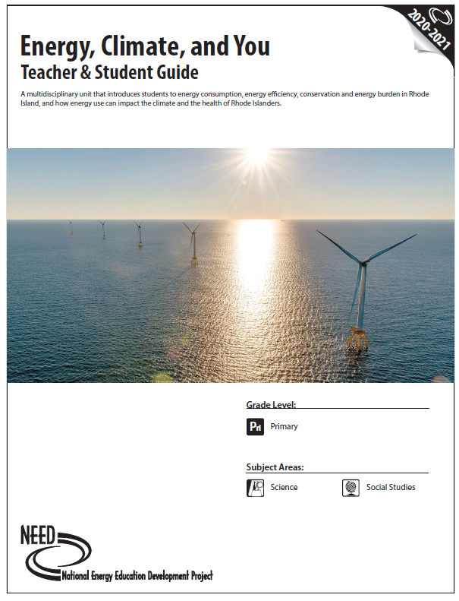
Notes:
As recommended by EERMC, we have utilized the NEED energy guides to develop the energy section of our curriculum. The National Energy Education Development Project designs and delivers energy education programs and these guides are available for teachers for free on the NEED website.
It has a focus on the NEED energy curriculum, which highlights energy information specific to Rhode Island.
*This presentation is focused on providing a general understanding of energy and its implications. However, it does focus on the State of Rhode Island at many points. If you are teaching this course in another state, we highly recommend looking at your state's energy consumption, production, and related repercussions. The links listed below can help you learn more about energy in your state!*
Energy consumption: https://www.eia.gov/state/rankings/
Energy production: https://www.energy.gov/articles/how-much-energy-does-your-state-produce

Slide 6
Primary Slides contain simplified information. Look for this mark to compile major points and create a simplified lesson.
PRIMARY
PRIMARY SLIDES
Notes:
If you intend to shorten this lesson, we have simplified it to include slides that are labeled as “Primary.” These slides contain a simplified explanation of information that is key to constructing a well-rounded understanding of energy. If all of these slides are compiled into a smaller lesson, they will accommodate a single day of energy education.

Slide 7
DEFINING ENERGY FOR DIFFERENT LEVELS OF EDUCATION
ELEMENTARY STUDENTS
HIGH SCHOOL STUDENTS
BOTH
TEACHERS
Mix, match and modify these slides to suit your students needs!
Notes:
You will also notice that the slides have different colored lines near the upper left hand corners. The NEED curriculum defines energy education topics differently regarding elementary students in comparison to middle and high school students. The Blue lined slides are intended to suit the educational needs of elementary school students, while the content of the red lined are aimed at middle and high school students. Slides with both borders can apply to either group, and slides with no lines are mainly intended for teachers.
We recognize that not all students may have a background in energy, regardless of their grade or age. For this reason, a simplified explanation of each primary topic is offered in both categories. Feel free to mix, match, and modify these slides as you see fit for your students. An editable version will be provided to you after this presentation.

Slide 8
The Sections
1
2
3
4
5
WHAT IS ENERGY?
WHY DO WE NEED ENERGY?
WHO IS AFFECTED & WHAT ARE THE CURRENT
COMPLICATIONS OF ENERGY PRODUCTION & USE?
WHERE CAN THE IMPACTS OF CURRENT ENERGY PRODUCTION METHODS BE SEEN?
HOW CAN WE HELP IMPROVE ENERGY USAGE?
Notes:
To start, we will take a look at the structure of this presentation. This brief overview serves to clarify the methods behind this presentation’s creation while also making it easier for you to return to this presentation and edit it for use in your own class.
In total, this presentation consists of five major sections;
What Is Energy?
Why Do We Need Energy & What Are The Current Compilations?
Who Is Affected By Energy Production & Use?
Where Can The Impacts Of Current Energy Production Methods Be Seen?
How Can We Help Improve Energy Usage?
These sections are meant to address the what, why, who, where, and how of this topic in a student-friendly manner. Each section covers a variety of points that are condensed into just a few slides, allowing you to mix and match important parts from this lesson as you see fit.

Slide 9
A STUDENT-FOCUSED EDUCATION ON ENERGY
Let's get started!
Notes:
Now, let's get started with the student-focused part of this presentation and work towards a stronger understanding of energy!

Slide 10
Section #1
WHAT IS ENERGY?
Notes:
Section 1 – What is Energy?

Slide 11
WHAT IS THE FIRST THING THAT COMES TO MIND WHEN YOU HEAR THE WORD ENERGY?
Notes:
What is the first thing that comes to mind when you hear the word energy? You may share your ideas in the chat window.

Slide 12
VARYING VIEWS
HOW DO YOUR STUDENTS VIEW ENERGY?
BY STARTING THE LESSON WITH A QUESTION, YOU CAN GAIN A BETTER UNDERSTANDING OF HOW WELL THE CLASS UNDERSTANDS THIS TOPIC.
Notes:
As adults, our minds might jump to energy bills and gas, but students are likely to answer differently.
By starting the lesson with this question, you can gain a better understanding of how well the class understands the topic.

Slide 13
QUESTION BASED ACTIVITY
What is Energy?
Notes:
This question can be transformed into an interactive activity if you are looking to enhance student engagement.
Hand out slips of paper
Have students write their answer
Handing out slips of paper for students to write their answers on and anonymously putting the answers on the board is an option for full class engagement that minimizes pressure.
Organize those papers on the board for discussion and later use

Slide 14
QUIZ BASED ACTIVITY
Notes:
This could also be turned into a Quiz Based Activity allowing a few students who raise their hands to answer or using an energy-specific quiz on a trivia platform like Kahoot. This question can be presented in a variety of ways, so get creative to encourage engagement in this topic early on.

Slide 15
QUESTION BASED ACTIVITY
Hand out slips of paper
Have students write their answer
Organize those papers on the board for discussion and later use
Interactive and lightly competitive activities help engage students. Platforms like Kahoot are a great option.
What Is Energy?
QUIZ BASED ACTIVITY
Notes:
As Teachers – You already know this – There is no “one fit for all” answer when it comes to engagement. So you may use a combination of these methods.
Before we wrap-up today’s session - we will do a Kahoot so that you can get a feel for it. As mentioned previously, all the materials we show during the session will be made available for you, and you may customize them to suit your needs.

Slide 16
What is Energy?
Notes:
Alright..back to the question? So What is Energy?

Slide 17
Energy is the ability to do work!
…Ability to move
…Ability to
We use Energy to
…we use Energy to
…
…we use Energy to
Notes:
ENERGY is the ability to do work in our everyday lives, like ability to move, ability to walk, run and jump.
We use energy to walk and play, dance, we use energy to speak, to bicycle, to move cars along roads.
We use Energy to run our trains, boats through water, to fly airplanes and to send our astronauts into space.
We also use Energy to cook on our stove or microwave, to bake our cakes in oven

Slide 18
We use Energy to make
…to
…Our toys & gadgets use energy to run.
…use energy to play
Energy also runs Technology
Notes:
The List goes on how and where we use Energy. We use energy to make ice in our freezers, to light our homes and offices.
We use energy to manufacture products, your toys and gadgets.
In fact, our toys and gadgets also use energy to run, to play our favorite songs and movies. Energy also runs technology, which is exactly why you need to charge your phone and appliances like your TV, radio and refrigerators

Slide 19
IN SIMPLE TERMS,
Energy Creates Change
Notes:
In the simplest terms, energy creates change.
One of the beautiful things about teaching an energy-focused curriculum is that energy relates to most things. This allows for easy segways between topics within energy, and it means that your students are very likely to answer that introductory question correctly. Once your students have engaged with the first question, all of their answers and understanding of energy can be boiled down to one memorable and overarching theme in energy.

Slide 20
Energy Is Something That We...
SEE
FEEL
DO
GROW FROM
PLAY WITH
LOOK FOR A LIGHT SOURCE AROUND THE ROOM, THAT IS ENERGY.
IF YOU RUB YOUR HANDS TOGETHER FAST YOU WILL FEEL HEAT, THAT IS ENERGY.
ENERGY CREATES MOVEMENT. WHEN YOU MOVE ,YOU USE ENERGY.
WATCH A PLANT GROW OR TRACK YOUR HEIGHT. THAT GROWTH COMES FROM ENERGY.
WHY DO YOU NEED TO CHARGE YOUR PHONE AND ADD BATTERIES TO TOYS? ENERGY!
Notes:
While older grades may have a comprehension of the role energy plays in daily life, some students will find it helpful to engage with a simplified recap of how energy is experienced.
According to the NEED curriculum, this extra explanation of energy as light, heat, growth, movement, and electricity is best aimed at elementary students. However, you are free to decide if your students would be interested in adding engaging experiences regardless of their grade.
Light is a form of energy we can see. It comes from the sun, fire, and man made lights. Heat is a form of energy that we can feel, it comes from a variety of activities, and you can feel it if you rub your hands together very fast. Energy makes things grow, including people, plants, and animals. Energy creates movement in people and all of our vehicles. Energy also runs technology, which is exactly why you need to charge your phone and plug-in appliances.

Slide 21
HIGHLIGHTING THE MAJOR FORMS OF ENERGY IN A MEMORABLE WAY
What Type of Energy Is It?
Kinetic Energy
Potential Energy
A tight rubber band
Singing
A Coiled Spring
TV
Boiling water
Throwing a ball
An unbroken glow stick
A ball at the top of a hill
Driving a car
Notes:
This concept is expanded upon as the major forms of energy are introduced. This primary concept includes an explanation of the nine forms of energy. For elementary students, these energy forms may be more difficult to comprehend or remember, so images are highly recommended, and matching games may be useful in establishing a working knowledge of these concepts. You can even use the answers from the prior question based activity to clarify this point, as shown here. If students already have a general understanding of these concepts, a trivia game may better encourage them to apply and refine their understanding.

Slide 22
What Are The Two Major Forms Of Energy?
POTENTIAL ENERGY
KINETIC ENERGY
STORED ENERGY THAT CAN BE APPLIED LATER.
ENERGY THAT IS IN MOTION.
POTENTIAL ENERGY
KINETIC
ENERGY
KINETIC
ENERGY
PRIMARY
EACH OF THESE ENERGY FORMS CAN BE BROKEN DOWN INTO MORE SPECIFIC TYPES OF ENERGY.
Notes:
What are the two major forms of energy, and how are they different?
Potential energy is stored energy that can be applied later. Kinetic energy is energy that is in motion. Each of these energy forms can be broken down into more specific types of energy

Slide 23
PRIMARY
TYPES OF POTENTIAL ENERGY
Gravitational
Elastic
Chemical
Nuclear
Energy from a place or position.
Energy from compressed or stretched objects.
Energy stored between the bonds of atoms and molecules.
Energy stored in the nucleus of an atom.
A raised weight
Water behind a dam
A book on a shelf
A parked car on a hill
A coiled spring
A diving board under pressure
A bow before the arrow is released
Unlit fireworks
The wick of a candle
Iron before it rusts
Wood before it burns
Nuclear fusion; the joining of atoms
Nuclear fission; the separating of atoms
Nuclear powerplants
Notes:
Potential energy includes four subsets of energy. They are:
Gravitational = Energy from a place or position.
Elastic = Energy from compressed or stretched objects.
Chemical = Energy stored between the bonds of atoms and molecules.
Nuclear = Energy stored in the nucleus of an atom.

Slide 24
TYPES OF POTENTIAL ENERGY
Gravitational
Elastic
Chemical
Nuclear
Energy from a place or position.
Energy from compressed or stretched objects.
Energy stored between the bonds of atoms and molecules.
Energy stored in the nucleus of an atom.
Notes:
Many of these energy types may be new to elementary grade students, so we have included a variety of images to help encourage connections between the word and energy type.
Middle school and high school students are offered the same definitions for the forms of potential energy, but they are given more examples.

Slide 25
PRIMARY
TYPES OF KINETIC ENERGY
Electrical
Radiant
Thermal
Motion/
Mechanical
Sound
Energy created by the movement of electrons.
Electromagnetic energy that travels in an up and down motion.
The vibration and movements of atoms within a substance.
Energy that creates waves from vibrations that move side to side.
Energy used in the movement of an object from one place to another.
Lightning
Electric eels
Batteries in use
Plugged-in electronics
Sunshine
X-rays & CT scans
Radio waves
Lightbulbs
Boiling water
Yellowstone Geysers
Baking with an oven
Swinging a hammer
A car in motion
A rolling bowling ball
Singing
Instruments
Earbuds & speakers
Buzzing bugs
Notes:
Kinetic energy includes five subsets of energy. They are:
Electrical = Energy created by the movement of electrons.
Radiant = Electromagnetic energy that travels in an up and down motion.
Thermal = The vibration and movements of atoms within a substance.
Motion = Energy used in the movement of an object from one place to another.
Sound = Energy creates waves from vibrations that move side to side.

Slide 26
TYPES OF KINETIC ENERGY
Electrical
Radiant
Thermal
Motion/
Mechanical
Sound
Energy created by the movement of electrons.
Electromagnetic energy that travels in an up and down motion.
The vibration and movements of atoms within a substance.
Energy that creates waves from vibrations that move side to side.
Energy used in the movement of an object from one place to another.
Notes:
Once again, many of these energy types may be new to elementary grade students, so we have included a variety of images to help encourage connections between the word and energy type.

Slide 27
MATCHING GAMES
or
Potential
A ball on top of a hill
Playing a drum
“What has more thermal energy, a cold chocolate milk or hot cocoa?”
Kinetic
An apple hanging in a tree
SIMPLE QUESTIONS
Turning on the TV
Notes:
The goal of this presentation is to get students more engaged with and educated on the topic of energy in relation to sustainability. If you are linking this lesson to a pre-existing energy curriculum, feel free to take whatever time your students need to expand upon and fully understand these types of energy. Matching games and simple questions, like “What has more thermal energy, a cold chocolate milk or hot cocoa?” should help solidify these concepts. Otherwise, a general understanding of these energy types should be sufficient to reach an understanding of modern energy usage and sustainability.

Slide 28
THE LAW OF CONSERVATION OF ENERGY
Energy cannot be destroyed; it is simply transformed into different forms of energy.
Notes:
Once a realization of energy’s prevalence in every aspect of life and its major forms are established, it is time to introduce the next concept.
Energy can not be destroyed; it is simply transformed into different forms of energy.
This is the Law of Conservation of Energy, and surprisingly it is not related to sustainability. Instead, it states how all of the energy in the universe has always existed and is constantly recycled.

Slide 29
Energy Transformations
We turn those plants into food
Radiant Energy
Plants transform radiant energy from the sun to chemical energy so they can grow.
Our bodies turn these plants into chemical energy that we use to play and grow.
Notes:
To better expand on this concept, it can be helpful to offer a visual sequence of energy use.
For example: Plants use sunlight to grow. Once they are fully grown, we eat them. Once you eat those plants, your body turns them into energy. When you play, that energy is turned into heat, carbon dioxide, and a variety of other energy forms that are continuously transformed and used by the earth.

Slide 30
PRIMARY
Complex Energy Transformations
Consider how much energy and how many transformations are required for seemingly simple items.
Planting the seeds
Watering systems
Corn comes from a cycle of electrical, mechanical, and radiant energy conversions.
Many of these activities also come with a variety of unintentional energy conversions.
Plowing the fields
Harvesting machines
Eating the corn for energy
Sorting machines
Cooking the corn
Transportation to stores
Transportation home
Notes:
This concept can be expanded upon if you have your students consider all of the energy required to generate a single meal. For example, energy is used to plow the fields in which food grows. If that food is grown on a large scale, machines use electricity to plant the seeds. Watering systems consume energy to water and grow those seeds, especially in areas with limited rainfall. If the food in question is a big crop like corn, machines are also needed to harvest, sort, and transport it to a store near you. Once that corn is bought, energy is used in the form of heat to cook it, and only after all of those energy conversions are complete are you able to eat the corn and gain energy from it. In the case of a whole meal, each item, down to the seasonings, needs a multi-step energy conversion process if it is to end up on your plate.

Slide 31
30% TO 40%
Of Food In The USA Goes To Waste.
If energy can't be destroyed, then why is this waste?
What does the chemical energy of food become if we don’t eat it?
Can you think of other items with energy conversion chains?
Notes:
That's a pretty crazy concept, especially when you consider how much food goes to waste every year and converts to energy types that don't directly benefit our needs. These energy conversion chains exist for every good we purchase or consume, and it can be interesting to explore some other items as a class activity or homework assignment, like clothes and toys.
You can also ask students to point out energy transformations or show them more examples in which they can identify what type of energy is being transformed and what energy it is transforming into.

Slide 32
CLASSIFYING ENERGY SOURCES
Renewable & Non-Renewable Energy Sources.
Notes:
The idea of energy transformation is important because it clarifies that energy is always available. However, it may not be available in the desired form unless it is actively transformed.
This brings us to another classifier of energy; renewable vs. nonrenewable.

Slide 33
PRIMARY
What Are The Two Classifications Of Energy Sources?
NON-RENEWABLE ENERGY
RENEWABLE ENERGY
ENERGY SOURCES FOUND WITHIN THE EARTH THAT ARE NOT EASILY OR QUICKLY REPLENISHED.
ENERGY SOURCES THAT ARE RAPIDLY REPLENISHED AND NOT EXCLUSIVELY DEPENDENT ON THE INNER EARTH.
EACH OF THESE ENERGY CLASSIFICATIONS CAN BE BROKEN DOWN INTO MORE SPECIFIC TYPES OF ENERGY.
Notes:
Nonrenewable energy sources are defined as energy sources that are limited. These energy sources are found within the earth, and they are not easily or quickly replenished. In contrast, renewable energy sources are defined as energy sources that are rapidly replenished and not exclusively dependent on the inner earth.
In the United States, most of our energy comes from nonrenewable energy sources. We will talk about this in detail in the coming slides

Slide 34
PRIMARY
Re-NEW-a-ble
Able to be NEW again
Types of Renewable Energy Sources
Biomass
Solar
Geothermal
Hydropower
Wind
.
Notes:
Some energy sources can
be made again quickly

Slide 35
PRIMARY
TYPES OF RENEWABLE SOURCES
Biomass
Solar
Geothermal
Hydropower
Wind
Anything that is or was alive, especially plants and trash.
Sunlight can be converted into heat or electricity through the use of solar panels.
Energy that is produced by the heat that exists beneath the earth’s surface.
Energy that is generated by water experiencing a gravitational pull.
Energy from wind is captured and transformed into electricity.
Notes:
Renewable resources include:
Biomass = Anything that is or was alive, especially plants and trash. Both of which can be burned to create electricity.
Solar = Sunlight can be converted into heat or electricity through the use of solar panels.
Geothermal = This is energy that is produced by the heat that exists beneath the earth’s surface. It can be used to regulate the temperature of a building or generate electricity depending on how it is transformed.
Hydropower = Energy is generated by water experiencing a gravitational pull. This is most commonly seen when water is contained in a reservoir behind a dam and is slowly let out of the dam.
Wind = Energy from the wind is captured and transformed into electricity when it spins the pinwheel-like blades of a wind turbine.

Slide 36
PRIMARY
NON-re-NEW-a-ble
NOT Able to be NEW again
Types of Non-Renewable Energy Sources
Coal
Petroleum
Natural Gas
Propane
Uranium
.
Notes:
Some energy sources take
millions of years or more to form.
Fossil fuels are nonrenewable energy
sources made from plants and animals
that lived a long, long time ago

Slide 37
PRIMARY
TYPES OF NON-RENEWABLE SOURCES
Coal
Petroleum
Natural Gas
Propane
Uranium
A shiny black rock that is derived from long-buried prehistoric swamp plants.
An oil product of life that existed long before dinosaurs.
This gas was formed in the same way as petroleum, but it is odorless and colorless.
This is a specific gas taken out of petroleum and natural gas.
This is the oldest form of nonrenewable energy, and it is stored in the earth’s early crust. It is full of nuclear energy.
Notes:
Nonrenewable resources include:
Coal = This shiny black rock holds a lot of energy derived from long-buried prehistoric swamp plants.
Petroleum = This is an oil product of life that existed long before dinosaurs, and today it is dug up and turned into gasoline, jet fuel, and diesel fuel.
Natural Gas = This gas was formed in the same way as petroleum, but it is odorless and colorless. We commonly use it to heat our homes, and its name can be misleading. (link to GBRI natural gas course)
Propane = This is a specific gas taken out of petroleum and natural gas. This gas can then be compressed into a liquid for grills or heating homes.
Uranium = This is the oldest form of nonrenewable energy, and it is stored in the earth’s early crust. It is full of nuclear energy that can be turned into electricity.

Slide 38
WHATS THE MAJOR DIFFERENCE?
Renewable energy sources provide an opportunity for humans to continue harvesting energy for many years.
In contrast, non-renewable energy sources have the possibility of running out.
Notes:
Now that both nonrenewable and renewable resources have been covered, their differences in accessibility can be emphasized. Renewable energy sources are identified as sustainable energy sources since they provide an opportunity for humans to continue harvesting energy for many years. In contrast, nonrenewable energy sources have the possibility of running out, amongst other negative impacts, which will be covered in the next section.

Slide 39
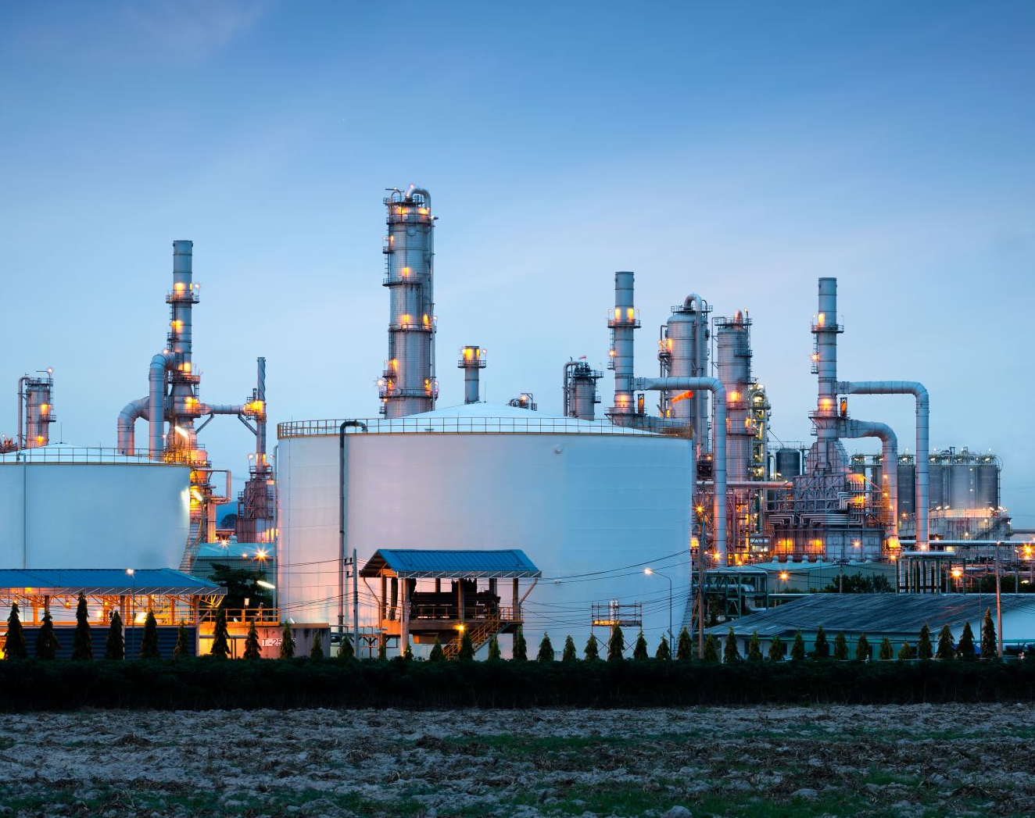
U.S.
primary energy consumption
by energy source 2020
Energy Consumption in the US (Source – EIA.Gov
Notes:
Let’s look at the United States’ primary energy consumption by energy source source.
On the screen, you are looking at a donut chart or donut graph. The data presented here comes from the EIA.gov website or Energy information Agency website. In 2020, 88% of the energy consumed in the US came from non-renewable sources of energy, and only 12% came from renewable sources of energy.
Let’s look at the break-up. Petroleum which is a non-renewable source of energy accounted for about a third of U.S. energy consumption, followed by natural gas at 34%.

Slide 40
What Percentage Of the USA's Energy Consumption is Renewable ?
Notes:
As I mentioned on the previous slide, renewable only accounted for 12% of US energy

Slide 41
What Percentage Of the World’s Energy Consumption is Renewable ?
Notes:
According to a news report in the BBC, Solar and wind and other clean sources generated 38% of the world's electricity in 2021.
And for the first time 10% of the total energy came from wind and solar energy. Fifty countries got more than a tenth of their power from wind and solar sources and out of which Netherlands, Australia, and Vietnam were the fastest to switch to wind and solar.
As the world's economies continue to rebound from the Covid-19 pandemic in 2021, demand for energy is soaring.
Since the demand for electricity is growing at a record pace, there is also a surge in using coal power.
https://ember-climate.org/insights/research/global-electricity-review-2022/

Slide 42
20%
20
With wind power being most prominent
17%
With hydropower being most prominent
WHAT PERCENT OF THE USA’S ELECTRICITY PRODUCTION IS RENEWABLE ?
15
10
5
0
2018
2020
Notes:
While renewable energy sources may not currently make up a majority of the U.S.’s energy production, they do hold a significant and growing impact.
Let’s look at the electricity generation and its sources.
In 2018, around 17% of the United States electricity was produced from renewable resources, with hydropower taking the lead.
In 2020, about 60% of U.S. utility-scale electricity generation was produced from fossil fuels (coal, natural gas, and petroleum), about 20% was from nuclear energy, and about 20% was from renewable energy sources.
The renewable energy share is expected to grow to 22% in 2022 according to EIA.gov

Slide 43
U.S. utility-scale ELECTRICITY generation by energy source 2020
https://www.eia.gov/energyexplained/electricity/electricity-in-the-us-generation-capacity-and-sales.php
Notes:
While renewable energy sources may not currently make up a majority of the U.S.’s energy production, they do hold a significant and growing impact.
Let’s look at the electricity generation and its sources.
In 2018, around 17% of the United States electricity was produced from renewable resources, with hydropower taking the lead.
In 2020, about 60% of U.S. utility-scale electricity generation was produced from fossil fuels (coal, natural gas, and petroleum), about 20% was from nuclear energy, and about 20% was from renewable energy sources.
The renewable energy share is expected to grow to 22% in 2022 according to EIA.gov

Slide 44
U.S.
primary ENERGY consumption
by energy source 2020
U.S. utility-scale ELECTRICITY generation by energy source 2020
12% from renewable energy sources
20% from renewable energy sources
https://www.eia.gov/energyexplained/electricity/electricity-in-the-us-generation-capacity-and-sales.php

Slide 45
Electricity is a secondary source of
energy.
All electricity is energy, but not all energy is electricity.
Notes:
Energy and electricity are often used interchangeably, though they aren't the same thing. This is probably due to the fact that the world's most recognizable form of energy is electricity. But it fits the old formula: All electricity is energy, but not all energy is electricity.
Electricity is different from the other energy
sources because it is a secondary source of
energy. We have to use another energy source to
make electricity. In the United States, natural gas
is the number one energy source for generating
electricity.

Slide 46
RHODE ISLAND'S RENEWABLE ENERGY RESOURCES
In 2019 about 9% of Rhode Island’s in-state electricity came from renewable resources.
In 2020 12% of Rhode Island’s in-state electricity came from renewable resources.
Home of America’s first operational offshore wind farm.
Notes:
In 2019 about 9% of Rhode Island’s in-state electricity came from renewable resources. Solar and wind are considered to be the primary renewable resources used in Rhode Island as of recently. They have even become the home of America’s first operational offshore wind farm and have multiple solar farms.
In 2020, about 12% of Rhode Island's in-state electricity came from utility-scale (1 megawatt or larger) and small-scale generating facilities that produced power from renewable energy sources, half of that from solar energy. Both solar and wind energy surpassed biomass for the first time in 2020 to provide a larger amount of the state's renewable generation. Hydropower supplied an additional small amount of the state's renewable electricity.³⁶

Slide 47
Rhode Island has renewable energy standards in place to increase the amount of renewable energy used by retail electricity providers over time.
WHAT DO YOU THINK THIS WILL RESULT IN AND WHY?
WHY DO YOU THINK THAT RHODE ISLAND USES PRIMARILY SOLAR AND WIND FOR ITS RENEWABLE ENERGY?
Notes:
The state has renewable energy standards in place to increase the amount of renewable energy used by retail electricity providers over time.
What do you think this will result in and why?
Why do you think that Rhode Island uses primarily solar and wind for its renewable energy?
These questions may be open-ended, but they provide a segway to the next section of the energy curriculum, “Why Do We Need Energy & What Are The Current Compilations?”

Slide 48
Block Island Wind Farm in Rhode Island is America’s first offshore wind farm
Notes:
This is the conclusion of the first section, “What Is Energy?” so feel free to leave your students wondering about how their home state is engaging with renewable energy sources, and possibly even share the location of the offshore wind farm with students who may be able to see it on future trips across the state.
There is a hyperlink on this slide if you are interested to see the source

Slide 49
Review Of Section 1: What Is Energy?
PRIMARY
Energy Creates Change.
Energy Comes In Two Major Forms:
Potential Energy
(This includes gravitational, elastic, chemical, and nuclear energy)
Kinetic Energy
(This includes electrical, radiant, thermal, sound, and motion energy)
Energy can NOT be created or destroyed, only transformed.
Energy Sources Are Categorized Into Two Major Groups:
NONRENEWABLE Energy Sources
(These includes coal, petroleum, natural gas, propane, and uranium)
Renewable Energy Sources
(These includes biomass, solar, geothermal, hydropower, and wind)
Notes:
Hopefully, the topic of energy is still fresh in your student’s minds. If you are presenting this curriculum in multiple parts or your students need a refresher, feel free to use the review slide of the first section as shown here.

Slide 50
Activities
Notes:
Learning activities are great ways to engage students. We have a few activities for each section that were adapted from the NEED guide.
Under this section, there are 3 activities you may utilize for your kids depending on their grade levels.
For primary and elementary kids, the candy collector exercise is fun activity designed to introduce students to the terms “renewable” and “nonrenewable”. The 2nd activity is Energy round-up - a quick and fun way for students to learn more or check their understanding about energy sources. Students will be able to identify an energy source as renewable or nonrenewable, and will be able to list some simple facts about each of the energy sources.
The instructions for each activity along with a slide deck is available for you all. Once again, you can modify these powerpoint slides to make it even better.
You may check out the activities before you begin the next section. Thank you and see you soon!

Slide 52
Energy Source Cards
Non-Renewable Energy Sources
Petroleum
Coal
Natural Gas
Propane
Uranium
Renewable Energy Sources
Hydropower
Biomass
Geothermal
Wind
Solar

Slide 53
Energy Source Facts
NON-RENEWABLE ENERGY SOURCES
RENEWABLE ENERGY SOURCES
PETROLEUM
HYDROPOWER
I am most used for transportation fuel.
A lot of me is imported from other countries.
Most of me is refined into gasoline.
I’m number one in the U.S., providing 37 percent of America’s total energy consumption.
I am a liquid found in rocks underground.
I require the Earth’s gravity to work.
I make electricity.
I only work in certain areas around water.
My facilities can disrupt wildlife and fish populations.
The water cycle is important to me. I can’t generate electricity without rain.
COAL
BIOMASS
I am used to make electricity.
I’m transported mostly by trains.
When I am burned, I make dust, soot, and chemicals.
I’m America’s most available fossil fuel.
I am a rock that must be mined.
I can be used to generate electricity.
I can be used to make transportation fuel.
Burning me can produce air pollution.
I get my energy from wood, garbage, and other waste.
My name means living materials.
NATURAL GAS
GEOTHERMAL
I am used to make electricity.
I’m transported mostly by trains.
When I am burned, I make dust, soot, and chemicals.
I’m America’s most available fossil fuel.
I am a rock that must be mined.
I can be used to make electricity.
I can be used for home heating and cooling.
My energy comes from the Earth’s core.
My name means heat from Earth.
You have to go below ground to get to me.

Slide 54
Energy Source Facts
NON-RENEWABLE ENERGY SOURCES
RENEWABLE ENERGY SOURCES
URANIUM
WIND
I am used only for generating electricity.
2. My atoms have lots of energy inside them.
3. My power plants are called reactors.
4. I come from rocks that are mined from the Earth.
5. Workers at my powerplants wear special clothing to keep them
safe from radiation.
I require the Earth’s gravity to work.
I make electricity.
I only work in certain areas around water.
My facilities can disrupt wildlife and fish populations.
The water cycle is important to me. I can’t generate electricity without rain.
PROPANE
SOLAR
I am used to make electricity.
I’m transported mostly by trains.
When I am burned, I make dust, soot, and chemicals.
I’m America’s most available fossil fuel.
I am a rock that must be mined.
I can be used to generate electricity.
I can be used to make transportation fuel.
Burning me can produce air pollution.
I get my energy from wood, garbage, and other waste.
My name means living materials.

Slide 55
Thank You

