Slide 1








A TEACHER’S GUIDE TO
ENERGY
Giving Life and Creating Change
Notes:
Hello and welcome to GBRI’s presentation for energy education. As educators, you make an important impact on the minds of the future. We want to support your mission in enhancing your students' education, especially in relation to sustainability.

Slide 2

Learning Hub @ GBRI
Presents
Notes:
Jjjjjjj hfdfhhf

Slide 3


Slide 4





The Sections
1
2
3
4
5
WHAT IS ENERGY?
WHY DO WE NEED ENERGY?
WHO IS AFFECTED & WHAT ARE THE CURRENT
COMPLICATIONS OF ENERGY PRODUCTION & USE?
WHERE CAN THE IMPACTS OF CURRENT ENERGY PRODUCTION METHODS BE SEEN?
HOW CAN WE HELP IMPROVE ENERGY USAGE?
Notes:
To start, we will take a look at the structure of this presentation. This brief overview serves to clarify the methods behind this presentation’s creation while also making it easier for you to return to this presentation and edit it for use in your own class.
In total, this presentation consists of five major sections;
What Is Energy?
Why Do We Need Energy & What Are The Current Compilations?
Who Is Affected By Energy Production & Use?
Where Can The Impacts Of Current Energy Production Methods Be Seen?
How Can We Help Improve Energy Usage?
These sections are meant to address the what, why, who, where, and how of this topic in a student-friendly manner. Each section covers a variety of points that are condensed into just a few slides, allowing you to mix and match important parts from this lesson as you see fit.

Slide 5
Section #2
WHY DO WE NEED ENERGY?
Notes:
Why Do We Need Energy & What Are The Current Complications?

Slide 6






THINK ABOUT THIS QUESTION IN RELATION TO YOUR LIFE...
Why do we need energy?
Notes:
A brief review should prepare your students to answer the next question, “Why do we need energy?”
This question should be relatively easy and help students connect the topic to their personal life. Do your best to use your understanding of energy to receive and clarify each student-given example to the class.
At the end of this discussion, energy should have been acknowledged in homes, schools, transportation, stores, food, factories, and whatever else your students can think of. The goal of this discussion is to highlight locations where energy is used so they may be organized in the next topic of this section, energy use sectors.

Slide 7







ENERGY USE SECTORS
TRANSPORTATION
COMMERCIAL BUILDINGS
Primary energy consumption includes four sectors that use energy.
Secondary energy consumption includes a fifth sector that transforms energy for use by the primary sectors.
INDUSTRIES
RESIDENCES
ENERGY TRANSFORMATION
Notes:
Energy use sectors are important because they show which activities are consuming the most energy and where change can be made. The energy sectors are broken down into two forms, primary energy consumption, and total energy consumption. Primary energy consumption includes four sectors that use energy, while total energy consumption includes a fifth sector that transforms energy for use by the other sectors.

Slide 8











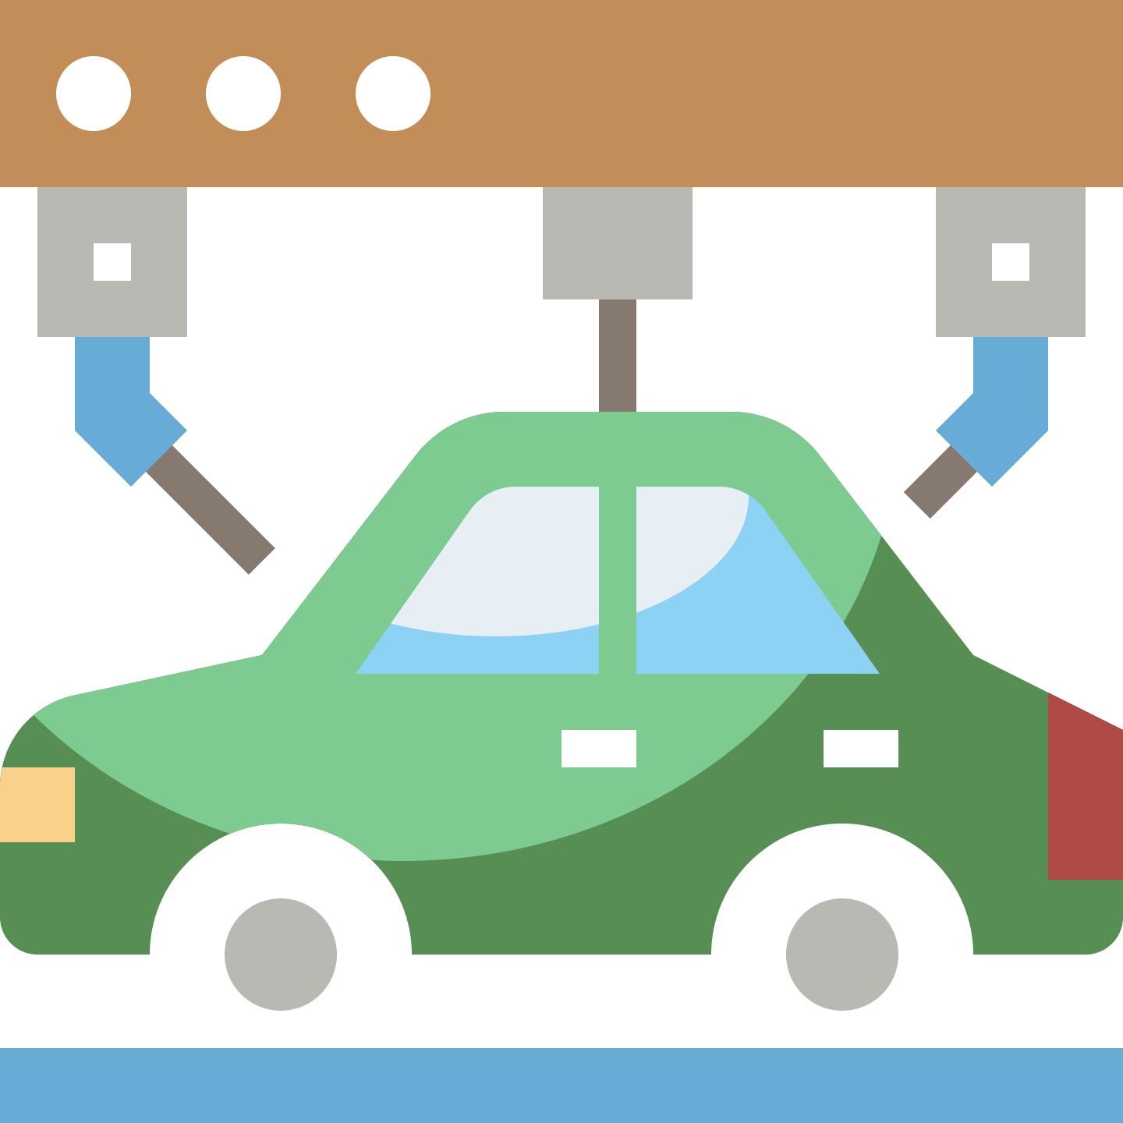

Commercial Buildings
12%
This sector includes schools, offices, hospitals, and stores.
Transportation
35%
This sector includes all vehicles used for transport, including trains, boats, cars, planes, and cargo vessels.
Residences
17%
Primary Energy Consumption Sectors
These include homes, apartments, and other residences of all sizes.
PRIMARY
Industries
36%
This sector includes all factory and industrially produced products, including everything from toys to cars.
Notes:
The industrial sector consumes the most energy in the U.S. at 36% of all primary energy consumed in 2020. This sector includes all factory and industrially produced products, including everything from toys to cars.
The transportation sector is the second most energy-intensive, using 35% of primary energy in 2020. This sector includes all vehicles used for transport, including boats, cars, planes, and cargo vessels.
Next in line are the residences. These include homes, apartments, and other residences of all sizes. Together the residential sector used 17% of all primary energy in the U.S. for 2020.
Lastly, there is the commercial sector coming in at 12%. This sector includes schools, offices, hospitals, and stores.

Slide 9
Primary Energy Consumption Sectors
PRIMARY
Notes:
What will it look like in a donut graph? Older kids may like this.

Slide 10
Primary Energy Consumption Sectors
PRIMARY
Notes:
What will it look like in a donut graph? Older kids may like this.

Slide 11
Primary Energy Consumption Sectors

Slide 12



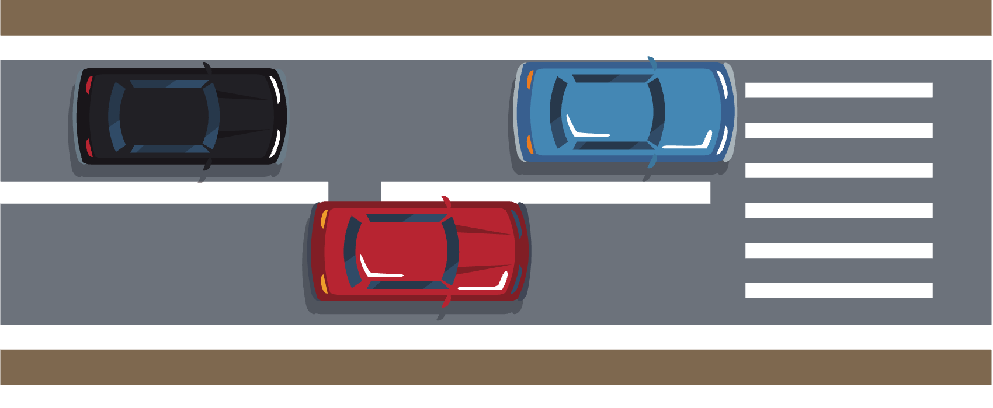
How Do Energy Sectors Relate To Your Life?
Cars are made in the...
Cars move you from the...
Industrial Sector
Residential Sector
Cars become part of the...
To your school, which is part of the...
Transportation Sector
Commercial Sector
Notes:
Now let’s see How Do Energy Sectors Relate To Your Life?
You are likely going to teach this curriculum while your students are in one of these sectors, and they have some tie to all of the sectors, even if it is a loose tie. Highlighting these interactions with each sector can be accomplished using a simple example like the one listed below.
The car, bus, or bike you traveled with is a part of the transportation sector. It is also a product of the industrial sector. It transports you from your home, which is part of the residential sector, to your school, which is part of the commercial sector.

Slide 13

THE FIFTH SECTOR
ELECTRIC POWER GENERATION
The electric power generation sector generates electricity by transforming other forms of energy, commonly coal or natural gas.
Notes:
Okay, so all of these sectors are intertwined in a way that your students have personally experienced, but how does the fifth sector of electric power generation fit in? This sector is directly linked to the ability of their school and home to function, so let's talk about that!
The electric power generation sector generates electricity by transforming other forms of energy, commonly coal or natural gas, through burning these substances. To fully comprehend how this process works, students must first understand that electricity is a product of atoms. For older students, a brief review of atoms may be sufficient.
On the other hand, younger students may be learning about the concept of electricity for the first time. In this case, a basic explanation should be sufficient to lead us to our next point, but this can also be combined with any pre-existing lessons on electricity that may be in your curriculum.

Slide 14
Review Of Section 2:
WHY DO WE NEED ENERGY?
  To fuel forms of transportation.
  For the industries that make our goods, like toys and clothes.
  To power our homes.
  For running life-saving services, like hospitals.
  To provide education at schools.
  And much, much more...
PRIMARY
Notes:
To fuel forms of transportation.
For the industries that make our goods, like toys and clothes.
To power our homes.
For running life saving services, like hospitals.
To spread education through schools.
And much, much more...
Take a short period of time to review the complications that come with modern energy use practices, nonrenewable resource depletion, global warming, pollution, etc. This review will be especially helpful if this section is being taught on a separate day from section two.

Slide 15




Activities
Notes:
Learning activities are great ways to engage students. We have a few activities for each section that were adapted from the NEED guide.
Under this section, there are 3 activities you may utilize for your kids depending on their grade levels.
For primary and elementary kids, the candy collector exercise is fun activity designed to introduce students to the terms “renewable” and “nonrenewable”. The 2nd activity is Energy round-up - a quick and fun way for students to learn more or check their understanding about energy sources. Students will be able to identify an energy source as renewable or nonrenewable, and will be able to list some simple facts about each of the energy sources.
The instructions for each activity along with a slide deck is available for you all. Once again, you can modify these powerpoint slides to make it even better.
You may check out the activities before you begin the next section. Thank you and see you soon!

Slide 16

Notes:
Today in Energy is designed to help students become aware of the ways they use energy every day. It introduces students to the concepts of choice, trade-offs, and cost. Students are given a limited amount of money (in energy bucks) for a day of activities. They are given 13 two-sided cards that have activity choices on either side. Students will use math and critical thinking skills to plan their day so that they can pay for their choices and still have fun.

Slide 17
Today in Energy Cards
TODAY IN ENERGY | TODAY IN ENERGY
1 – A | 1 -B
WINTER: WARM HOUSE ( T – SHIRT) | WINTER: COOL HOUSE (SWEATSHIRT)
OR | OR
SUMMER: COLD HOUSE (AIR CONDITIONER) | SUMMER: COOL HOUSE (FANS)
$3 | $2
TODAY IN ENERGY | TODAY IN ENERGY
2 – A | 2 - B
WAKE UP EARLY | SLEEP LATE
WALK TO SCHOOL | GET A RIDE TO SCHOOL
$0 | $1
TODAY IN ENERGY | TODAY IN ENERGY
3 – A | 3 –B
MAKE AND EAT EGGS | MAKE AND EAT CEREAL
FOR BREAKFAST | FOR BREAKFAST
$2 | $1

Slide 18
Today in Energy Cards
TODAY IN ENERGY | TODAY IN ENERGY
4 – A | 4 – B
MAKE AND EAT A SANDWICH | MAKE AND EAT A MICROWAVEABLE
FOR LUNCH | PIZZA FOR LUNCH
$1 | $2
TODAY IN ENERGY | TODAY IN ENERGY
5 – A | 5 - B
GO TO A CLUB MEETING OR SPORTS | PLAY VIDEO GAMES WITH FRIENDS
PRACTICE AFTER SCHOOL | AFTER SCHOOL
$1 | $2
TODAY IN ENERGY | TODAY IN ENERGY
6 – A | 6 – B
WALK HOME | GET A RIDE HOME
FROM SCHOOL | FROM SCHOOL
$2 | $1

Slide 19
Today in Energy Cards
TODAY IN ENERGY | TODAY IN ENERGY
7 – A | 7 – B
MAKE AND EAT AN AFTERNOON | NO
SNACK | AFTERNOON SNACK
$1 | $0
TODAY IN ENERGY | TODAY IN ENERGY
8 – A | 8 – B
STUDY IN DAYLIGHT | GO FOR A WALK
HANG OUT WITH FRIENDS LATER | BIKE – RIDE OR SNACK
$0 | $1
TODAY IN ENERGY | TODAY IN ENERGY
9 – A | 9 – B
WATCH A MOVIE | PLAY OUTSIDE
$0 | $1

Slide 20
Today in Energy Cards
TODAY IN ENERGY | TODAY IN ENERGY
10 – A | 10 – B
MAKE AND EAT | MAKE AND EAT
DINNER | DINNER
$2 | $2
TODAY IN ENERGY | TODAY IN ENERGY
11 – A | 11 – B
WATCH TV | READ A BOOK
$1 | $0
TODAY IN ENERGY | TODAY IN ENERGY
12 – A | 12 – B
HOT BATH | QUICK SHOWER
$2 | $1
TODAY IN ENERGY | TODAY IN ENERGY
13 – A | 13 – B
WINTER: WARM HOUSE (GO TO BED WITH HEAT TURNED UP AND BLANKETS) | WINTER: WARM HOUSE ( GO TO BED WITH HEAT TURNED DOWN AND BLANKETS)
OR | OR
SUMMER: COOL HOUSE ( AIR CONDITIONING) | SUMMER: COOL HOUSE (CEILING FAN)
$3 | $2

Slide 21


Thank You

