Slide 1
A TEACHER’S GUIDE TO
ENERGY
Giving Life and Creating Change
Notes:
Hello and welcome to GBRI’s presentation for energy education. As educators, you make an important impact on the minds of the future. We want to support your mission in enhancing your students' education, especially in relation to sustainability.

Slide 2
Learning Hub @ GBRI
Presents
Notes:
Jjjjjjj hfdfhhf

Slide 4
The Sections
1
2
3
4
5
WHAT IS ENERGY?
WHY DO WE NEED ENERGY?
WHO IS AFFECTED & WHAT ARE THE CURRENT
COMPLICATIONS OF ENERGY PRODUCTION & USE?
WHERE CAN THE IMPACTS OF CURRENT ENERGY PRODUCTION METHODS BE SEEN?
HOW CAN WE HELP IMPROVE ENERGY USAGE?
Notes:
To start, we will take a look at the structure of this presentation. This brief overview serves to clarify the methods behind this presentation’s creation while also making it easier for you to return to this presentation and edit it for use in your own class.
In total, this presentation consists of five major sections;
What Is Energy?
Why Do We Need Energy & What Are The Current Compilations?
Who Is Affected By Energy Production & Use?
Where Can The Impacts Of Current Energy Production Methods Be Seen?
How Can We Help Improve Energy Usage?
These sections are meant to address the what, why, who, where, and how of this topic in a student-friendly manner. Each section covers a variety of points that are condensed into just a few slides, allowing you to mix and match important parts from this lesson as you see fit.

Slide 5
Section #3
WHO IS AFFECTED & WHAT ARE THE CURRENT
COMPLICATIONS?
Notes:
Who Is Affected By Energy Production & Use? And What are the current complications of Energy Production and Use?

Slide 6
WHO IS AFFECTED BY ENERGY PRODUCTION & USE?
PRIMARY
Notes:
Who Is Affected By Energy Production & Use?

Slide 7
THINK ABOUT THIS QUESTION IN RELATION TO YOUR LIFE...
What would life be like without energy, or more specifically, electricity?
Notes:
These complications were shown to exist on both global and individual scales, so your students should be able to make both global and personal connections to how these complications can affect life.
What would life be like without energy, or more specifically, electricity?

Slide 8
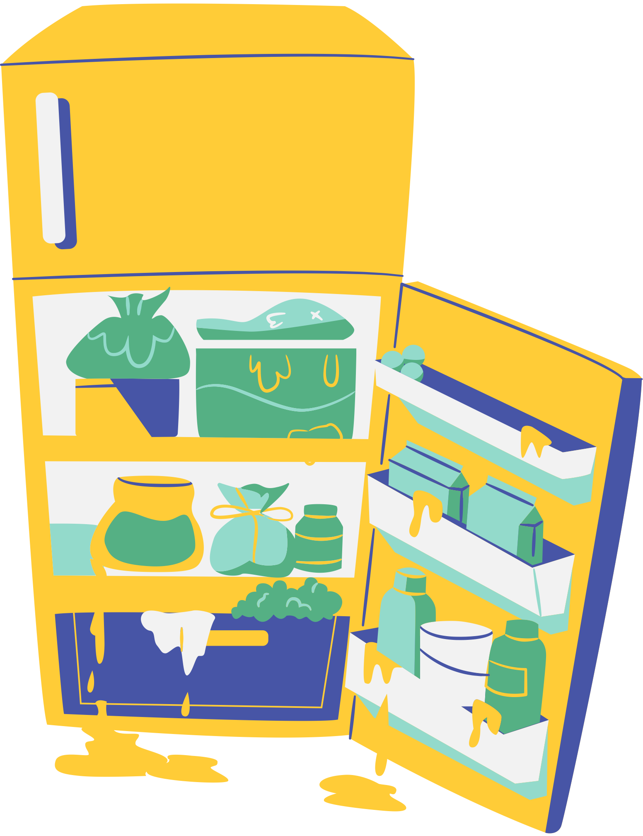
WHAT WOULD CHANGE WITHOUT ELECTRICITY?
It would be more difficult to store food.
Certain areas of the world would be too hot or cold to live in without heating, ventilation, and air conditioning systems.
Many modern medical practices would be impossible to perform.
Travel would be limited and much more difficult.
What else?
Notes:
In a generation of technology, many modern conveniences like phones and televisions would not exist. Challenge your students to think beyond their everyday items.
It would be more difficult to store food.
Certain areas of the world would be too hot or cold to live in without heating, ventilation, and air conditioning systems.
Many medical practices would be impossible to complete.
Travel would be much more difficult and be limited.
What else? This is an opportunity for you to open-up a discussion in the class.

Slide 9
OF THE GLOBAL POPULATION DEPENDS ON ELECTRICITY TO SOME EXTENT!
%
Notes:
In short, about 87% of the global population has access to electricity and depends on it to some extent. This means that shortages in electricity could affect a majority of the 7 billion people across the globe.

Slide 10
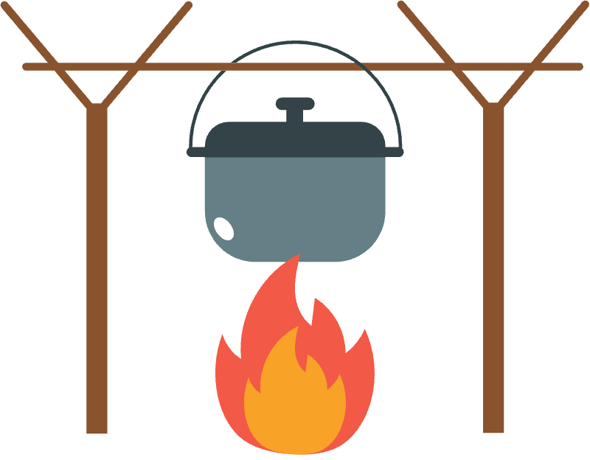
HOW WOULD YOUR LIFE BE DIFFERENT WITHOUT ELECTRICITY?
Consider Power Outages You Have Experienced.
Some Countries Have Scheduled Power Outages.
What Conveniences Are Missing On Camping Trips Without Power?
Notes:
Encourage students to explore and discuss what life would be like without energy. They should consider how it is during a power outage if they have ever experienced one or what it’s like on a camping trip. How would they entertain themselves, learn, or contact friends without electricity? Some countries have scheduled blackouts to take pressure off their grids. What would it be like knowing that you have no energy for a scheduled hour every day?
While many conveniences would be lost, it would also result in the loss of life-sustaining practices.

Slide 11
When something valuable begins to run out, what tends to happen?
+
High Demand
Increased Cost
Limited Supply
=
Notes:
The chances of electricity disappearing overnight are slim, but a continued dependence on nonrenewable energy sources will inevitably lead to a depletion of these sources. When something valuable begins to run out, what tends to happen?
Resources in high demand and low supply tend to increase in price. Electricity and gas are always in high demand since they power so many aspects of life, so if their supplies start to fall, their prices are likely to rise. This would result in many individuals being unable to afford the energy sources that they need to survive.

Slide 12
THE AVERAGE AMERICAN FAMILY PAYS
$2,200
A YEAR FOR UTILITIES LINKED TO ENERGY USAGE.
Families with limited financial resources may have to make tough decisions if energy costs rise.
Notes:
It is estimated that the average American family pays $2,200 a year for utilities linked to energy usage. Since these utilities are necessary for life, they are often prioritized, and for families with financial restrictions, prioritizing these payments can result in neglecting other important needs. For example, it is pointless to buy groceries if you don't have electricity to run your fridge and keep them cool, so families that have a tight budget may purchase less food in order to afford their utility costs.
If energy prices increase, then more families will be faced with these difficult decisions, and quality of life could decrease for numerous individuals.

Slide 13
WHAT ARE THE CURRENT COMPLICATIONS OF ENERGY PRODUCTION?
Notes:
Why Do We Need Energy & What Are The Current Complications?

Slide 14
What Is The Basis Of Electricity?
ATOMS
ATOMS ARE INVISIBLE BUILDING BLOCKS OF LIFE THAT HAVE THREE KEY PARTS.
PROTON
NEUTRON
ELECTRON
ELECTRONS CAN BE REMOVED, AND, IN SIMPLE TERMS, THIS CHANGE CREATES ENERGY.
Notes:
In order to understand the complications, we may have to look at some basics. The important context here is that atoms are invisible building blocks of life that have three key parts. These are the protons, neutrons, and electrons. These electrons can be removed, and, in simple terms, this change creates energy. This leads us to our next point, how energy travels.

Slide 15
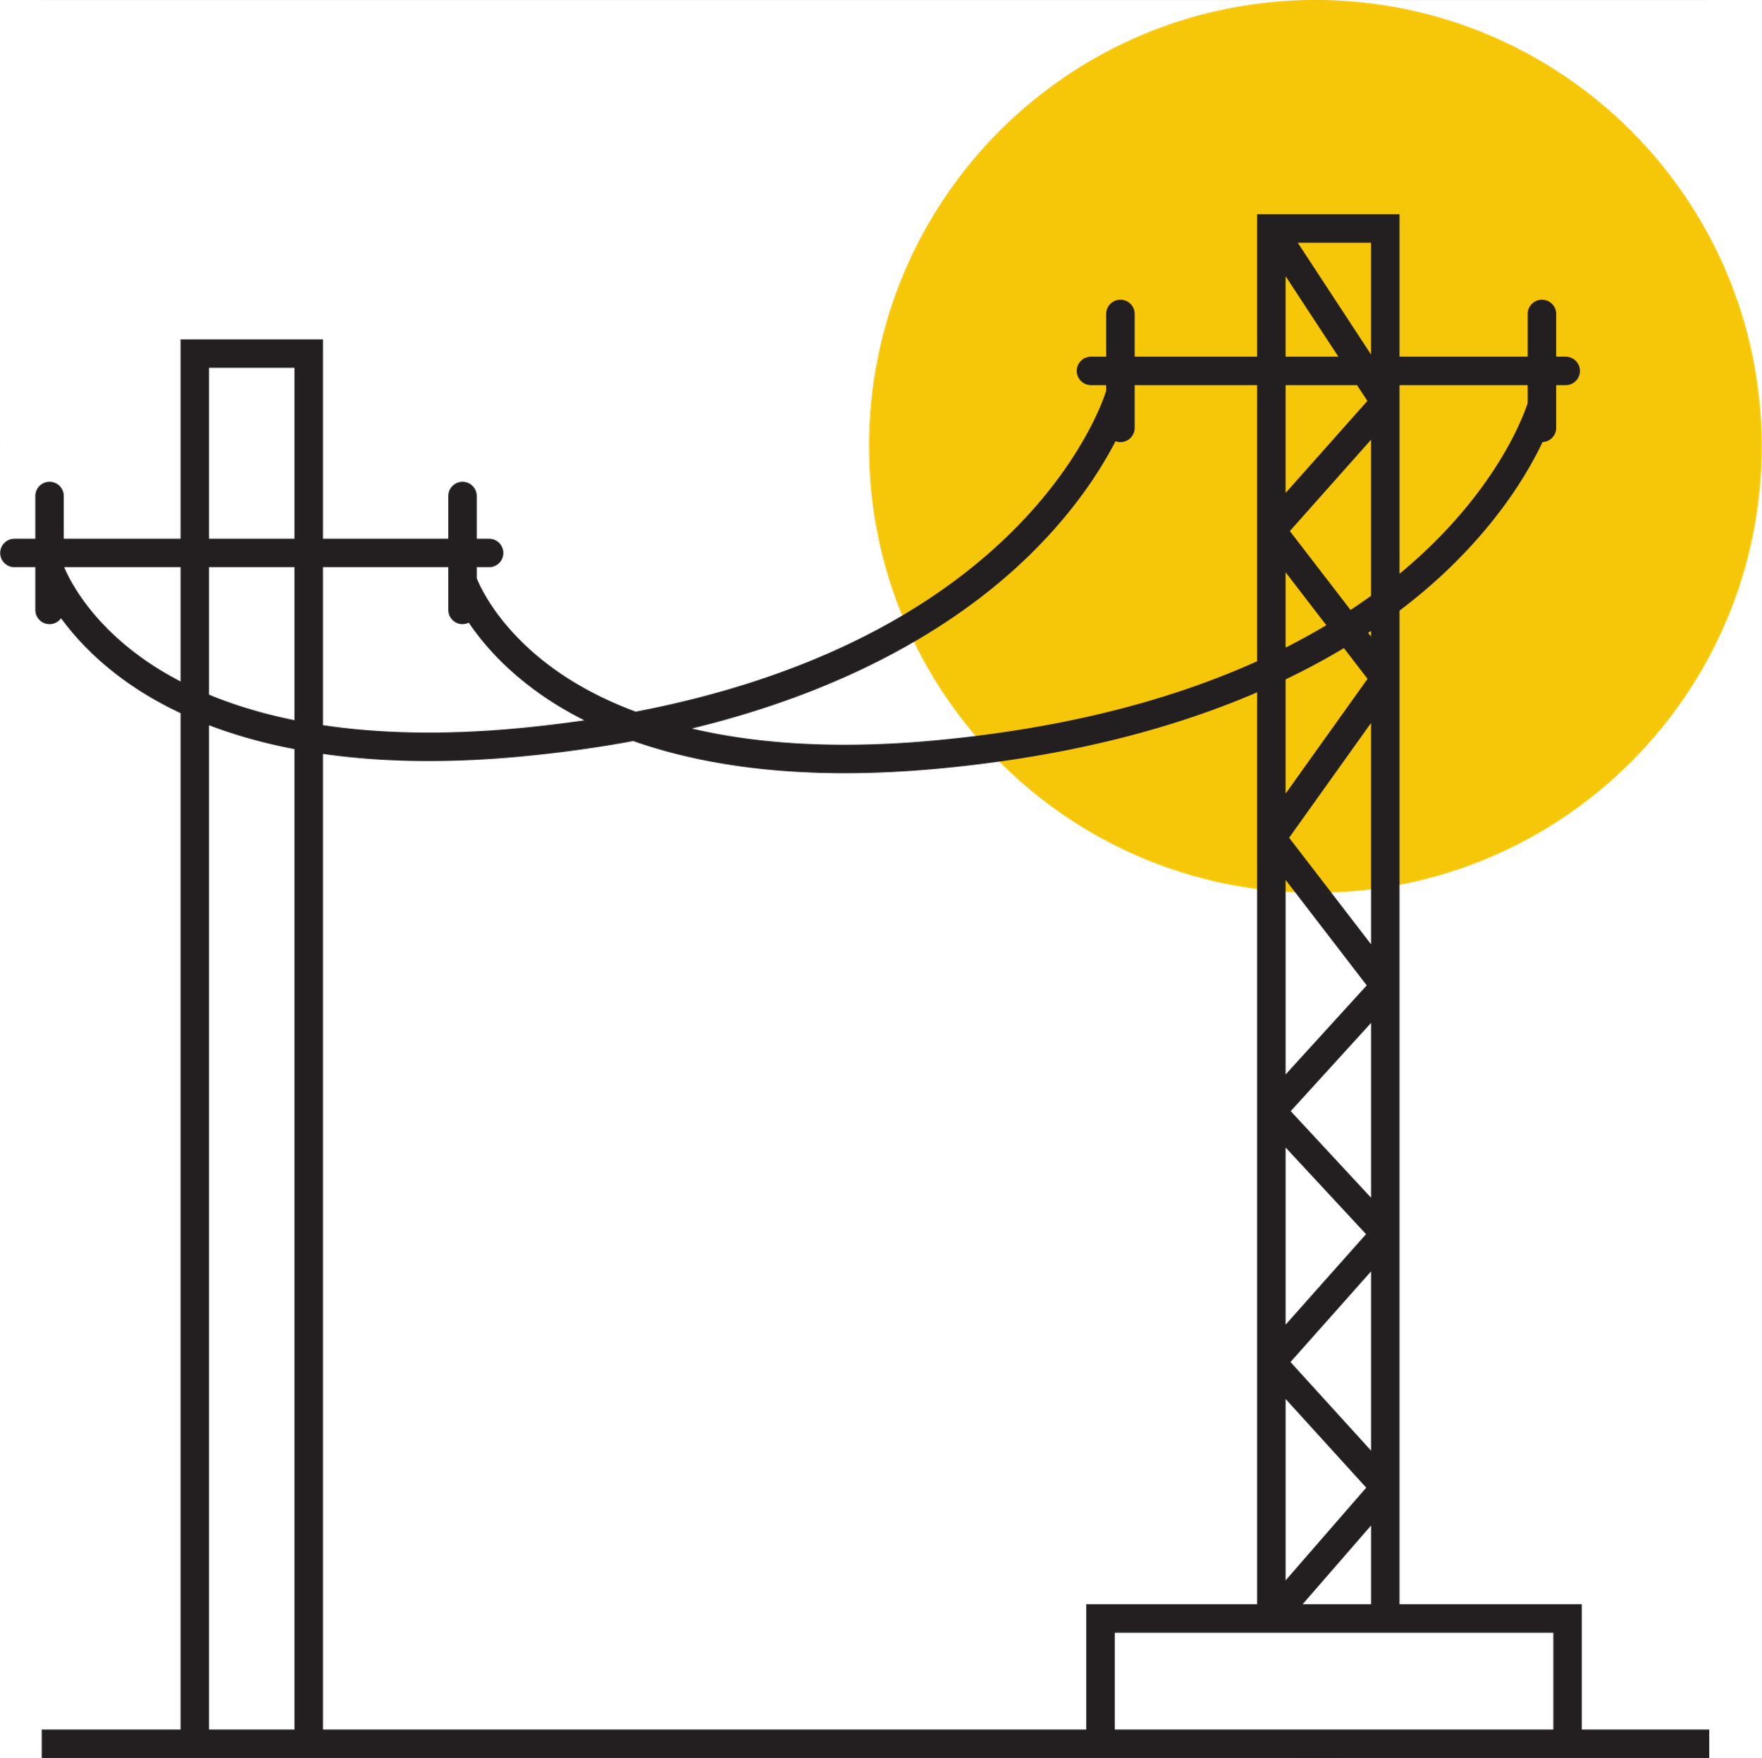
How Does Electricity Travel?
At Powerplants, turbines turn magnets that push and pull electrons in a machine known as a generator
The electricity travels through powerlines and transformers.
This creates electricity.
Eventually it ends up in the sectors where it will be used.
Notes:
Power Plants use turbines powered by the energy sources discussed prior to turn magnets that push and pull electrons in a machine known as a generator. The result of this process is electricity, and this electricity is transported through various power lines and transformers before it reaches the sectors where it is used.
During this process, electricity is lost in undesired transformations, regardless of all the resources that were needed to create it. This is just one of the complications that exists within the current systems of energy production and use.
We have created short video that shows how electricity is generated and hot it travels to your homes and schools.

Slide 16
During the creation and transportation process, electricity is lost in undesired transformations, regardless of all the resources that were needed to create it.
Where do you think electricity is lost?
Notes:
Where do you think electricity is lost?
This question is meant to get students of all ages thinking about how energy is used in non-productive ways, like when lights are left on during a bright day. Guide and support your students in a discussion as they make connections to their own lives through both major and minor wastes of electricity.

Slide 17
Electricity can be wasted in a number of ways, from the process of transporting it to the use of it. Consider all of the things electricity relates to.
Do you think wasting electricity is bad. If so, why?
Notes:
Do you think wasting electricity is bad, and why?
This question plays off of the first and requires students to make connections between how energy is made and how it is used. Concepts like a connection to global warming or inaccessibility due to rising prices may take time to develop and will be discussed further into this curriculum. For now, answers like, “more electricity will have to be made to make up for lost electricity,” and “more resources will be needed, especially if they are nonrenewable.” are great starting points.

Slide 18
NON-RENEWABLE RESOURCES
THIS IS A MAJOR SOURCE OF ENERGY PRODUCTION TODAY
THE COST OF NONRENEWABLE RESOURCED
As nonrenewable resources are depleted, energy can change in price and accessibility.
INCREASING USE OF NONRENEWABLE RESOURCED
Notes:
Much of the energy produced today is the result of nonrenewable resources, like those we had discussed earlier. As a result, this energy can change in price and accessibility as time goes on and the nonrenewable resources are depleted.

Slide 19
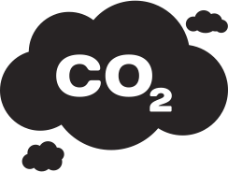
Power plant
Coal
Oil & Gas
Notes:
It is also worth noting that nonrenewable resources are found within the earth. Although their harvesting methods were not discussed here, their location implies that environmental disruption is necessary for their harvest. Coal, petroleum, and all of the other nonrenewable energy sources require drilling or digging, but they are also capable of disrupting the environment in another way.
When these nonrenewable energy sources are burned to create energy at power plants, they release compounds that pollute the environment. While these compounds originated from the earth, their use as an energy source causes a release of compounds at a rate faster than what the earth can break down.

Slide 20
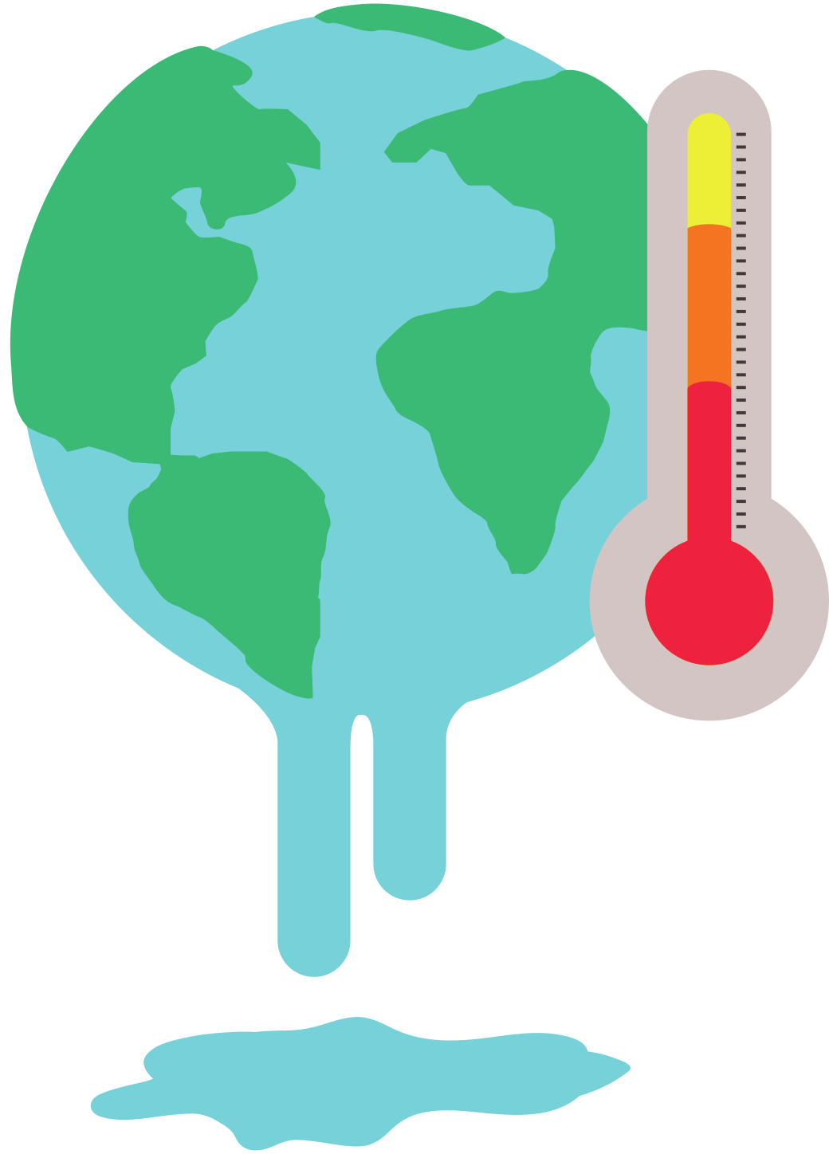
The Creation Of Carbon Dioxide
Carbon dioxide is concentrated in fossil fuels and released when they are burned for energy.
Normally, carbon dioxide is turned back into oxygen by plants and oceanic phytoplankton.
When there is too much carbon dioxide for the earth to transform, it builds up in the atmosphere. There it enhances the earth’s ability to retain heat.
Notes:
One of the most commonly discussed aspects of this pollution is considered to be carbon dioxide. This is a compound that we produce when we breathe, and it travels through the air before it is reabsorbed by the earth or converted into oxygen by plants.
Nonrenewable resources for energy have a high concentration of carbon that has been stored away in the earth for many years. When it is burned to produce electricity, this sequestered carbon is released into the atmosphere, where it enhances the earth’s ability to retain heat. Over time this is leading to a significant increase in the earth’s overall temperature.

Slide 21
CARBON DIOXIDE MAKES UP
80%
OF GREEN HOUSE GASES
More than half of current carbon dioxide emissions are from electricity production and the transportation sector.
Heat retention due to greenhouse gasses is known as global warming.
PRIMARY
Notes:
Carbon dioxide is one of a few major greenhouse gasses, and it is the most prevalent, making up 80% of all greenhouse gasses in 2019. Even more impressive is how more than half of this current carbon dioxide emissions are the result of electricity production and the transportation sector.
This condition of heat retention due to greenhouse gasses is known as global warming. While global warming is a popular topic currently, and its impacts will be discussed a bit more later in the curriculum, it may be helpful to have students define global warming and its effects in their own words.
At the end of any discussion on the complications of current energy production and consumption, students should have an understanding of the grand scope of energy’s impacts. This concept relates to how they use energy in their homes and makes the jump to how that same energy contributes to global issues.

Slide 22
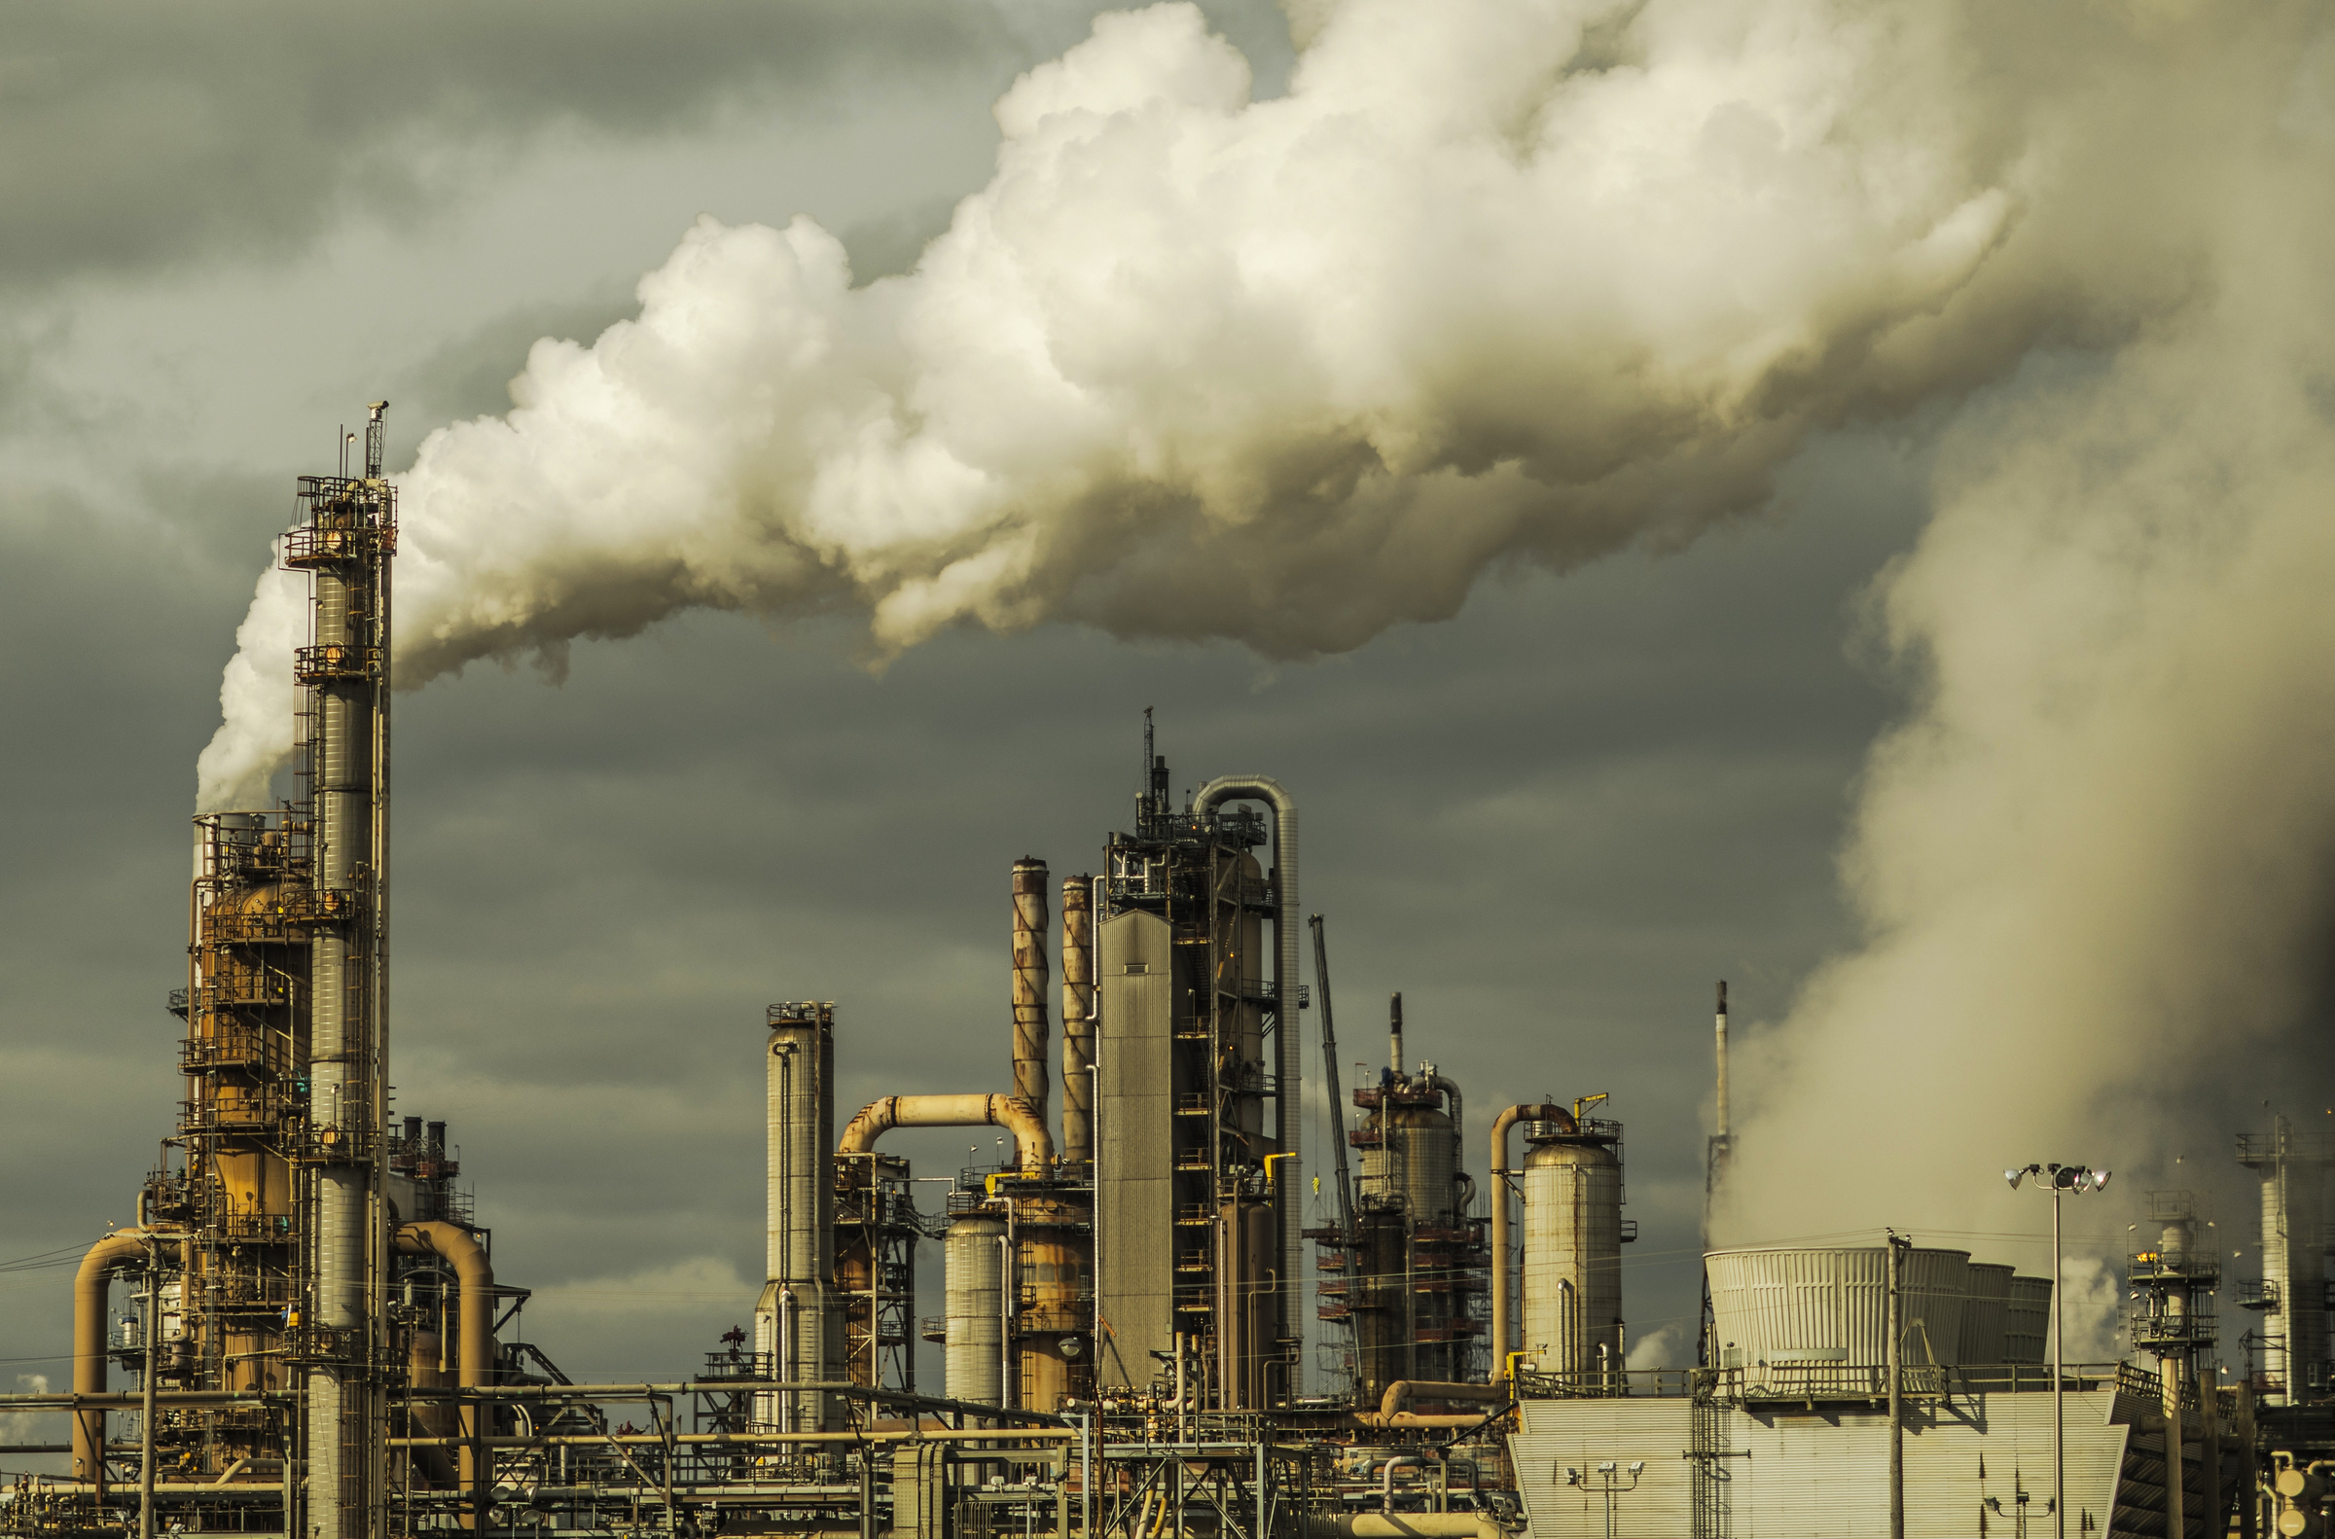
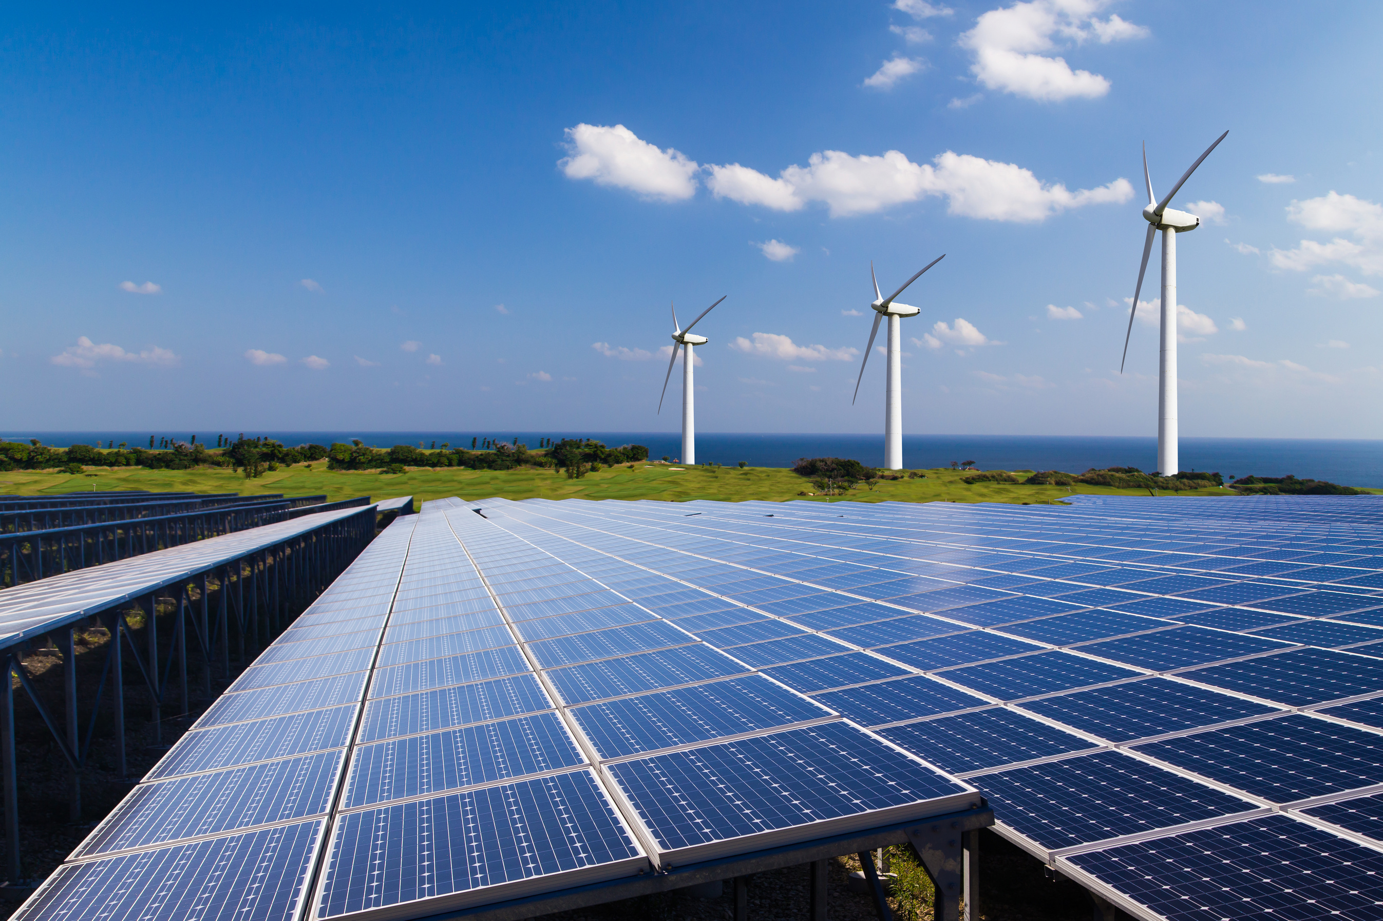
PRIMARY
POLLUTIVE ENERGY PRODUCTION
Pollutes the environment.
Drops the value of housing nearby.
Generates negative health effects for individuals in close proximity.
Does not negatively impact housing or health.
Does not pollute the environment.
CLEAN ENERGY PRODUCTION
Notes:
Pollutive energy production also directly impacts those close to its source. Since the burning of coal and other fossil fuels results in air pollution, the areas around these sites are generally considered undesirable and often marketed as lower-cost housing. As a result, individuals who live in these areas are exposed to pollutants that result in respiratory, cardiovascular, and many other health complications. States like California have found that a disproportionate amount of people of color and people who are poor are significantly affected by air pollution and its related health complications.
If these areas of energy production produced clean energy, then there wouldn't be areas where people are unjustly exposed to pollution. The impacts of energy production and use reach beyond people by affecting animals and the earth as well.

Slide 23
PRIMARY
GLOBAL WARMING
Long frozen areas, like glaciers at the poles, begin to melt, and sea levels rise.
Weather patterns can change or become more extreme due to changes in air temperatures and wind patterns.
The ocean becomes more acidic and less hospitable for sea life as it naturally sequesters carbon dioxide at unnaturally high levels.
Environments change in temperature, causing changes in foliage and sometimes even terrain.
Notes:
As global warming increases, the earth changes.
Long frozen areas, like glaciers at the poles, begin to melt, and sea levels rise.
Weather patterns can change or become more extreme due to changes in air temperatures and wind patterns.
The ocean becomes more acidic and less hospitable for sea life as it naturally sequesters carbon dioxide at unnaturally high levels.
Environments change in temperature, causing changes in foliage and sometimes even terrain.

Slide 24
What would happen if all the bees in an area died off due to environmental changes?
GLOBAL WARMING
ANIMAL POPULATIONS COLLAPSE & ECOSYSTEMS COLLAPSE
What other environmental systems can be damaged by global warming?
Notes:
In response to these environmental changes, animals change migration patterns, and those that can not survive the changes can become extinct. As humans, we depend on animals for survival, so this impacts us as well. When animal populations begin to collapse, ecosystems can also collapse.
Something as simple as the loss of large bee populations could seriously diminish the growth of plants, including the fruit and vegetable production that people depend on. Take some time to think of other animals that could be harmed by global warming or pollution, and how their depletion can also impact people's lives.

Slide 25
HARMFUL HARVESTING
While the burning of fossil fuels is detrimental, its harvesting and transport can be just as bad. Oil spills from mining rigs in the ocean can seriously harm enormous amount of fish and mammal.
Notes:
While the burning of fossil fuels is detrimental, its harvesting and transport can be just as bad. Oil spills from mining rigs in the ocean can seriously harm hundreds of thousands of sea animals, and on land, these practices have also proven to be concerningly pollutive.

Slide 26
The Heat Island Effect
The excessive concrete and stone in cities holds heat from the sun and actually increase the temperature of the surrounding area.
Notes:
As the use of nonrenewable energy resources continues to intensify global warming, it also promotes interesting cyclical events. One of which is the heat island effect, where densely populated cities have increased cement surfaces and high transportation rates. The excessive concrete and stone in these areas hold heat from the sun and actually increase the temperature of the surrounding area.

Slide 27
The Heat Island Effect
Large amounts of concrete and asphalt in cities absorb and hold heat.

Slide 28
The Heat Island Effect
People in these areas increase their cooling systems. This requires the production of more energy, which requires the burning of more fossil fuels. This results in more carbon dioxide contribution to global warming, and so the cycle repeats as it intensifies.
Notes:
As a result, people in these areas increase their heating, ventilation, air conditioning, and cooling systems. This required the production of more energy, which required the burning of more fossil fuels, and resulted in more carbon dioxide contribution to global warming. As global warming intensifies, so will the heat island effect, causing people to need even more air conditioning. And this cycle can continue indefinitely without inventive intervention.

Slide 29
The changes triggered by the use of non-renewable energy sources are experienced on a global scale.
Notes:
In many ways, the changes triggered by the use of nonrenewable energy sources come full circle and are so serious that they can be seen and experienced on a global scale.

Slide 30
Review Of Section 3: Who Is Affected By Energy Production & Use?
Energy production has a global impact.
Electricity supports modern food preservation, indoor climate control, medical practices, transportation, and much more.
87% of the global population depends on electricity to some extent.
Fossil fuels are of a limited supply and are in high demand. When they begin to run out we can expect an increase in prices and less energy accessibility.
Housing near pollutive powerplants is commonly less expensive, however it also comes with negative health impacts for those living there.
Global warming is another negative impact of using non-renewable energy.
Weather patterns, sea levels, environments, and cities experience changes due to global warming.
In some cases, like the heat island effect, global warming is a cycle that gains momentum through the use of fossil fuels.
PRIMARY
Notes:
Briefly review the impacts of current energy production, including global warming, rising sea levels, energy accessibility, and whatever else your class has previously discussed.
and unintentionally wasted (transformed into less useful forms).

Slide 31
Homework

Slide 32
Homework
Notes:
https://www.gbrionline.org/courses/climate-change-you-lets-get-the-basics-right/
https://www.gbrionline.org/climate-change-and-you-is-it-end-game-now/

Slide 33
Activities
Notes:
Learning activities are great ways to engage students. We have a few activities for each section that were adapted from the NEED guide.
Under this section, there are 3 activities you may utilize for your kids depending on their grade levels.
For primary and elementary kids, the candy collector exercise is fun activity designed to introduce students to the terms “renewable” and “nonrenewable”. The 2nd activity is Energy round-up - a quick and fun way for students to learn more or check their understanding about energy sources. Students will be able to identify an energy source as renewable or nonrenewable, and will be able to list some simple facts about each of the energy sources.
The instructions for each activity along with a slide deck is available for you all. Once again, you can modify these powerpoint slides to make it even better.
You may check out the activities before you begin the next section. Thank you and see you soon!

Slide 35
Thank You

