Slide 1








A TEACHER’S GUIDE TO
ENERGY
Giving Life and Creating Change
Notes:
Hello and welcome to GBRI’s presentation for energy education. As educators, you make an important impact on the minds of the future. We want to support your mission in enhancing your students' education, especially in relation to sustainability.

Slide 2

Learning Hub @ GBRI
Presents
Notes:
Jjjjjjj hfdfhhf

Slide 3


Slide 4





The Sections
1
2
3
4
5
WHAT IS ENERGY?
WHY DO WE NEED ENERGY & WHAT ARE THE CURRENT
COMPLICATIONS?
WHO IS AFFECTED BY ENERGY PRODUCTION & USE?
WHERE CAN THE IMPACTS OF CURRENT ENERGY PRODUCTION METHODS BE SEEN?
HOW CAN WE HELP IMPROVE ENERGY USAGE?
Notes:
To start, we will take a look at the structure of this presentation. This brief overview serves to clarify the methods behind this presentation’s creation while also making it easier for you to return to this presentation and edit it for use in your own class.
In total, this presentation consists of five major sections;
What Is Energy?
Why Do We Need Energy & What Are The Current Compilations?
Who Is Affected By Energy Production & Use?
Where Can The Impacts Of Current Energy Production Methods Be Seen?
How Can We Help Improve Energy Usage?
These sections are meant to address the what, why, who, where, and how of this topic in a student-friendly manner. Each section covers a variety of points that are condensed into just a few slides, allowing you to mix and match important parts from this lesson as you see fit.

Slide 5
Section #4
WHERE CAN THE IMPACTS OF CURRENT ENERGY PRODUCTION METHODS BE SEEN?
Notes:
Alright let’s get started with section 4. Where can we can we see the impact of current energy production and methods?

Slide 6
Impacts of Energy Production
Environmental
Social
Economic
Notes:
All energy production has environmental, societal and economic effects!
Let’s look at them closely.

Slide 7

1
Environmental

Slide 8





Environmental problems directly related to energy production and consumption include…
Air
Water
Climate
Heat
Waste
Air Pollution
Water Pollution
Climate Change
Thermal Pollution
Waste Disposal
Notes:
The environmental problems directly related to energy production and consumption include air pollution, climate change, water pollution, thermal pollution, and solid waste disposal.
All forms of electricity generation have an environmental impact on our air, water and land, but it varies.

Slide 9
Air emissions from the combustion of fossil fuels are the primary environmental impact of the U.S. energy system.
74% of total US GHG emissions came from burning fossil fuels in 2019.
Notes:
Air emissions from the combustion of fossil fuels are the primary environmental impact of the U.S. energy system. According to the EPA, 74% of total U.S. GHG emissions came from burning fossil fuels in 2019.

Slide 10

Air quality
is a measure of how clean the air is
Notes:
Air pollution is something we can all relate to who live in cities
To understand the impact on air, we should understand air quality.
Air quality is a measure of how clean the air is.

Slide 11
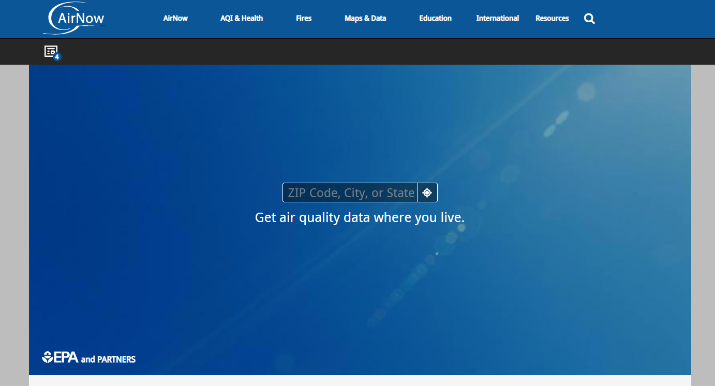

Air Quality Index
https://www.airnow.gov/
Notes:
The Air Quality Index or AQI is an index for reporting daily air quality. It tells you how clean or unhealthy your air is. On the screen, we have listed a government resource called “Air Now” where you can enter the zipcode of any US city to find out the air quality. AirNow reports air quality using the official U.S. Air Quality Index (AQI), a color-coded index designed to communicate whether air quality is healthy or unhealthy for you.

Slide 12
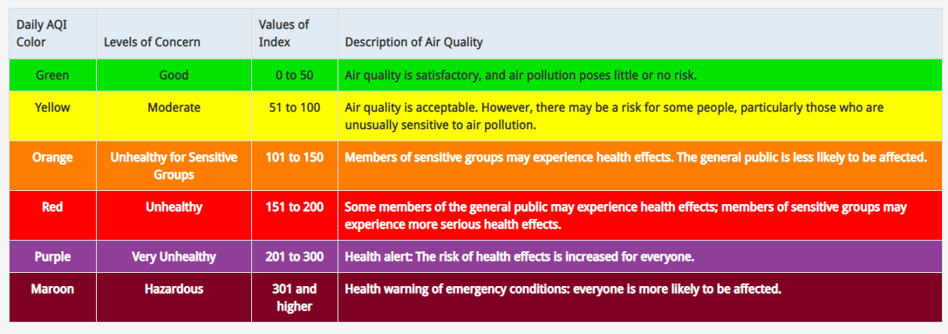
Air Quality Index
https://www.airnow.gov/aqi/aqi-basics/
Notes:
On the screen, you are looking a AQI table with the AQI ranging from zero to 500. And it tells us what each number or range means in terms of air quality and level of health safety.

Slide 13
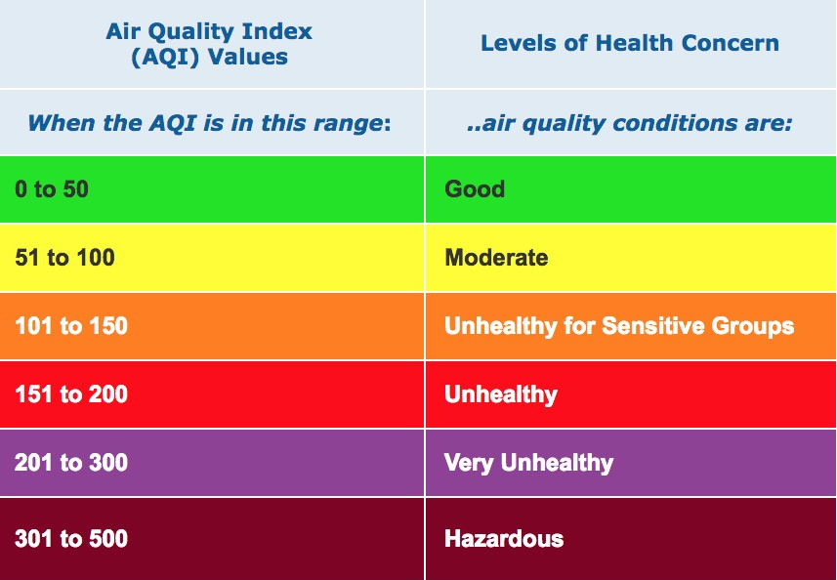

Poor Air Quality From Non-Renewable Resources
Air quality is a measure of how clean the air is. The burning of Non-Renewable energy sources creates low air quality and can result in people becoming sick, as well as damage to the environment.
Notes:
The burning of nonrenewable energy sources creates low air quality and can result in people becoming sick, as well as damage to the environment. Smog and oil spills, on the other hand, are two completely visible and sometimes tangible impacts.
In certain parts of the world, primarily highly populated areas like cities, outdoor air can be polluted by the burning of nonrenewable energy sources. This creates low air quality and can result in people becoming sick as well as damage to the environment.

Slide 14
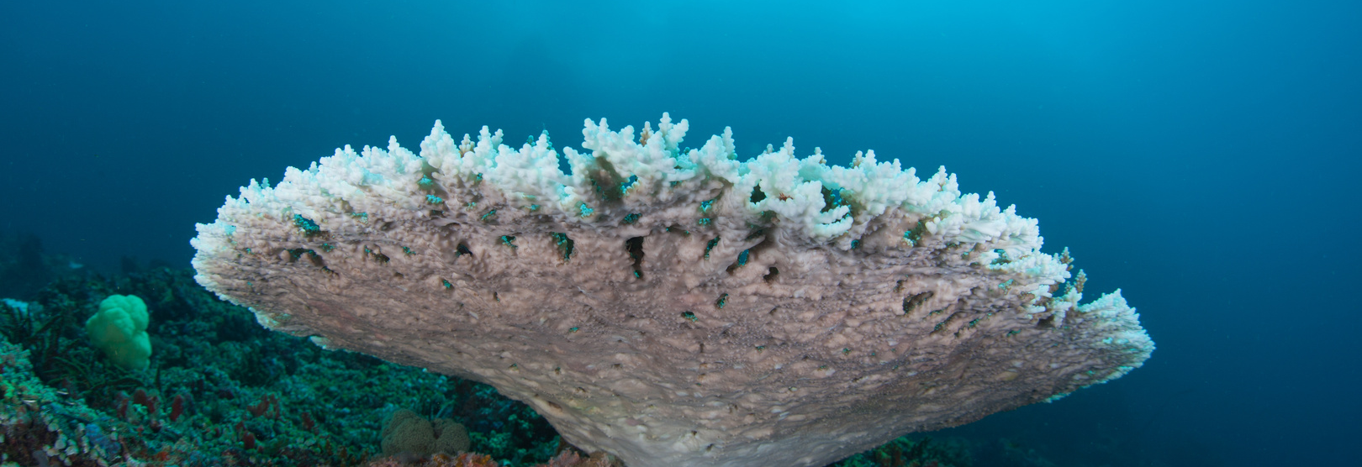

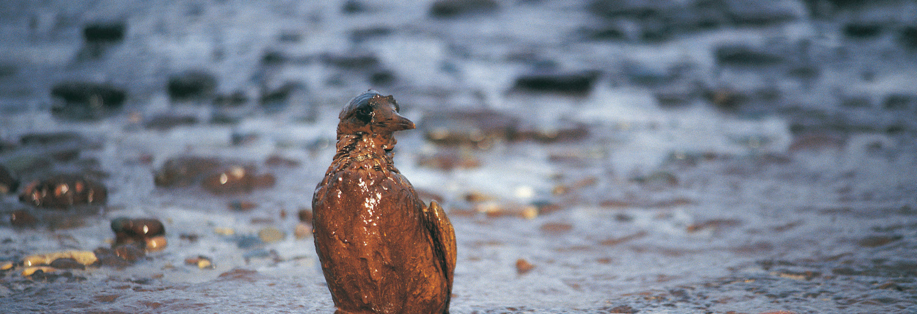
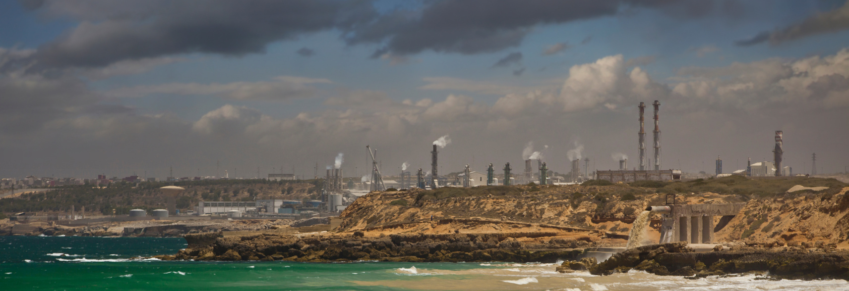
What Effects Of Non-Renewable Energy Production Can Be Seen?
Coral Bleaching
Receding Icecaps
Oil Spills
What Else Can You Think Of?
Notes:
Older students may have heard more about the effects of global warming and where they can be seen, so this offers a great opportunity to open a discussion with the class.
Events like coral bleaching from global warming induced ocean acidification are visible in images and hold significant impacts, like the collapse of diverse marine ecosystems.
Oil spills also tend to appear in recent news from time to time. While they are rarely experienced in person, images allude to their wide-reaching damage, and research shows their pollutive impacts extend far beyond the ocean’s surface.

Slide 15

2
Social Impacts
Notes:
As you would agree - Energy has positive impacts on societies. Are there negative impacts from energy production on societies?
Access to abundant, affordable, secure, safe, and clean energy is beneficial for humans. But energy extraction, transportation, and use can have negative consequences to the health, environment, and economics of a society.

Slide 16
Energy
Equity
Which communities are disproportionally affected?
Notes:
Unfortunately not all communities are affected equally from pollution that arise from energy production. Air pollution from coal is a short-term, local externality, meaning that people who live near the coal plant experience the negative impacts almost immediately. Poor or marginalized societies are more likely to suffer negative consequences of energy decisions because they have a reduced capacity for adaptation and they may lack negotiating power compared to wealthier societies
This brings to an important area of discussion – Energy equity. It’s a recognition that disadvantaged communities have been historically marginalized and overburdened by pollution, underinvestment in clean energy infrastructure, and lack of access to energy-efficient housing and transportation.

Slide 17
Disadvantaged communities are usually overburdened by pollution and underinvestment in clean energy infrastructure
Notes:
Disadvantaged communities are usually overburdened by pollution and underinvestment in clean energy infrastructure

Slide 18

3
Economic Impacts
Notes:
We need energy for a prosperous economy and hence energy has a has a positive impact on economy. But the question is when the world is strongly dependent on a finite supply of fossil fuels, what happens when there is a strong demand.
As demand increases and supply becomes scarce, the problem becomes more acute, with potentially severe economic and social consequences.
A large-scale transition away from fossil energy poses a great challenge for society. We will discuss the solution under section 5 but we want to acknowledge the economic impact of energy production.

Slide 19





Can All Energy Production Impacts Be Seen In Rhode Island?
Not all impacts are easily seen.
  Rising sea levels are difficult to see with changing tides.
  Changing weather patterns are difficult to identify without clear tracking.
  Increased temperatures are impossible to judge though feeling alone.
Notes:
Many of these impacts occur on a grand scale, which makes the results difficult to imagine. In an effort to make the impacts of nonrenewable energy production more tangible, we will take some time to discuss impacts that can be seen and even felt.
As a coastal region, Rhode Island is impacted by rising sea levels. With changing tides, this can be difficult to see short-term, although some older students may have noticed higher water levels at their favorite beaches.
Increased temperatures and related weather pattern changes are other impacts that are difficult for students to experience clearly. The financial aspect of nonrenewable resource costs is also may be beyond the understanding or personal experiences of many students.

Slide 20



Visible Air Pollution
The dark smoke released from the exhaust pipe of vehicles contains pollution that was caused by burning fossil fuels like petroleum.
This pollution is only temporarily visible because it disperses into the air.
Notes:
Due to its position near the ocean, geography, and minimal cities, Rhode Island generally maintains good outdoor air quality. However, air pollution is still visible. The dark smoke released from the exhaust pipe of vehicles contains pollution that was caused by burning fossil fuels like petroleum. This pollution is only temporarily visible because it disperses into the air, much like a single drop of food dye would disperse into a tank of water.

Slide 21
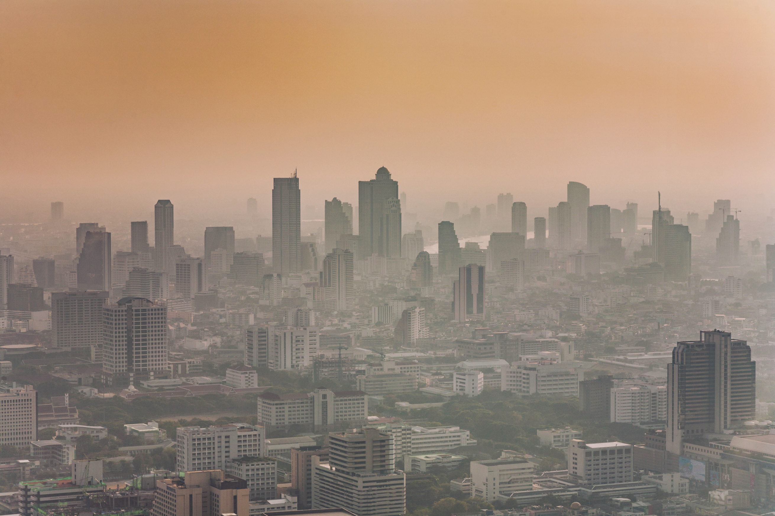
HAVE YOU EVER SEEN OR FELT
AIR POLLUTION?
Air pollution from fossil fuels becomes more apparent as more is added to the atmosphere.
Notes:
However, this does not mean that the pollution has disappeared. Instead, it has just dissipated. Air pollution from fossil fuels becomes more apparent as more is added to the atmosphere. The same can be seen if more food coloring is added to a tank of water. If any of your students have traveled to large cities, like New York, and felt the change in air quality, that is a great connection!

Slide 22
What Effects Of Non-Renewable Energy Production Can Be Seen?
Notes:
This is a good time to encourage students to think - What Effects Of Nonrenewable Energy Production Can Be Seen?

Slide 23






THINK ABOUT THIS QUESTION IN REATION TO YOUR LIFE...
What can we do to make a change and remove these damaging sources of energy from our daily lives?
Notes:
Most forms of nonrenewable energy sources leave a negative impact on the earth in some sense, whether they are visible or invisible. So what can we do to make a change and remove these damaging sources of energy from our daily lives?

Slide 24
Section #5
HOW CAN WE HELP IMPROVE ENERGY USAGE?
Notes:
How do you think we can minimize and eventually stop the damage being done by nonrenewable energy sources?

Slide 25




Activities

Slide 26



Slide 27


Thank You

